Slide 1

The LARC Quality Improvement Collaborative:
LEARNING SESSION II
How to be a Quality Ninja
IMPROVE
LARC

Slide 2
IMPROVE
Workbook, p. 63-76

Slide 3
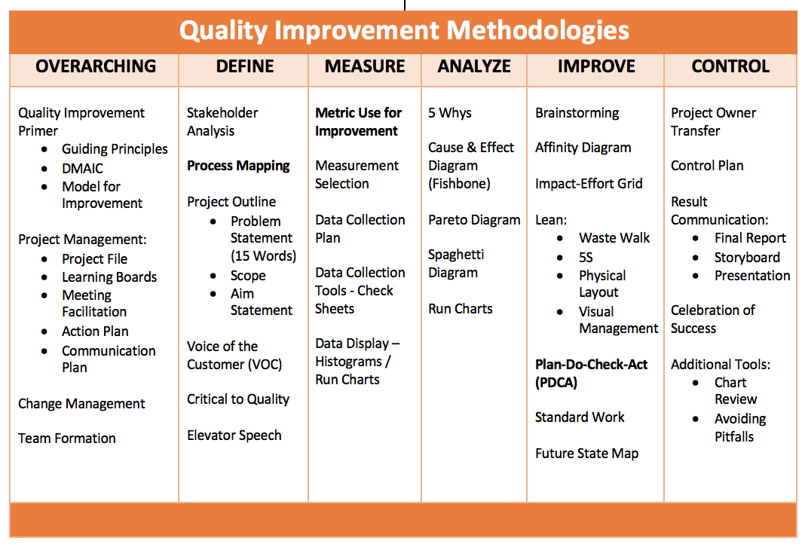

Slide 4
SESSION | Introductory Webinar | Smart Start: 2-Day On-Site | Learning Session #1 | Learning Session #2 | Learning Session #3
CONTENT | Quality Improvement Primer - Guiding Principles DMAIC Model for Improvement Data/ Measurement Overview Stakeholder Analysis Team Formation Planning for Smart Start / Process Mapping | DEFINE / MEASURE Process Mapping Brainstorming / Affinity Diagram Prioritize Opportunities for Improvement (OFIs) Impact/Effort Grid Project Outline Problem Statement Scope Aim Statement / Metric Elevator Speech Action Plan Communication Plan | Quality Improvement Review Smart Start Outputs PDCA Overview Project Mgmt. Change Mgmt. Voice of Customer Critical to Quality Data/Measurement ANALYZE 5 Whys, Cause & Effect Diagram, Pareto Diagram, Spaghetti Diagram, Run Charts/Control Charts | IMPROVE Simulation Before/After PDCA / Small Test of Change Lean 5S Visual Management Physical Layout Standardized Work Future State Process Map Data Display | CONTROL Process Owner Transfer Control Plan Result Communication Final Report Storyboard Presentation Spread Best Practices Celebrate Success Additional Tools Chart Review Avoiding Pitfalls

Slide 5
Project Deliverables
On-Site / Session 1
DEFINE / MEASURE / ANALYZE
Session 2
IMPROVE
Session 3
CONTROL
Identify Stakeholders
Team Formation
Map the Process (Current)
ID / Prioritize Opportunities
  Project Outline
Baseline Metrics - Data Collection Tool/Plan
Action Plan
Elevator Speech
VOC Information
Root Cause Analysis
1 Rapid/Small Test of Change (PDSA)
Presentation
  Update Project Outline, if necessary
1 5S Exercise
1 Visual Management Application
2 or more Tests of Change (PDSA)
Select and Implement Change
Modify Solution(s) where necessary by additional Test of Change (PDSA)
Create Future State Map
Create Standard Work
Presentation
Update Project Outline, if necessary
Validate Solution(s) / Interventions
Create Control Plan
Transfer to Operational Owner
Share/Spread Intervention, if applicable
Final Presentation
Project Champion
Notes:
Just in Time training to accomplish deliverables

Slide 6
Session 2 Deliverables
Improve
  Update Project Outline, if necessary
1 5S Exercise
1 Visual Management Application
2 or more Tests of Change (PDSA)
Select and Implement Change
Modify Solution(s) where necessary by additional Test of Change (PDSA)
Data Display
Create Future State Map
Create Standard Work
Presentation

Slide 7
simulation
/sɪmjuːˈleɪʃ(ə)n/
Noun
imitation of a situation or process
the action of pretending

Slide 8
ACTIVITY
Conduct an Emergency Department Simulation: Provide “care” (dots) to your “patients” (paper sheets) given your current environment – NO CHANGES ALLOWED
Follow Work Instructions
Goal: “Treat” as many patients as possible in the time given (5 MIN)
Debrief with the group
What you will need:
Table top signs (Workstations)
Work Instructions
Patients (Paper Sheets)
Dots (Care provided = Work)
Timer
Flip Chart
Markers
10 + 5 MIN
Notes:
ROOM SET UP
Set up room with 1, 2, or 3 simulations, 8 workstations each. Identify workstations with table top signs
With the first run of the simulation set up the workflow to be as difficult as possible, i.e. Place workstations not in order of numbers, 1 and 8 furthest apart, etc.
Put all supplies (dots) in store room
Put all patients (white sheets with open circles) in the waiting room

Slide 9
Work Instructions
Patients must be cared for in sequence. To assure proper and equitable care, patients can not by-pass processes or be cared for out of order. Each dot represents a work unit of approximately 5 minutes
Patients must be cared for properly with safety and quality in mind. Dots must be inside the circles for the procedure to meet requirements
Patients must be escorted by Transport from the waiting room and between all processes in groups of 5. When you have completed your care-giving responsibilities, call for Transport to move the patients to the next process
If the process runs out of dots, patients, or anything needed call for the Supplies person to order more
Quality Assurance will inspect each patient after they have been discharged to assure that the patient has received quality care. QA will track the Quality measures and the throughput time (time from start until first batch of patients completes treatment)
No process changes are allowed during this round as we want to understand and collect baseline data on the current process
Run for 5 minutes. When time is up, STOP and STEP AWAY from your patients
Notes:
Present work instructions – just read as written, provide no emphasis

Slide 10
The ED Simulation – Team Roles
We need:
1 Volunteer → Quick Registration
1 Volunteer → Triage
1 Volunteer → Full Registration
1 Volunteer → Treatment
1 Volunteer → Discharge
1 Volunteer → Quality Assurance
1 Volunteer → Transport
1 Volunteer → Supplies
1 Volunteer → Transport Spaghetti Map (optional)
Notes:
10
Say: Here are the roles for our ER exercise. Transport people should proceed to the waiting room and Supplies personnel should report to the Store Room (location of dots).
You will need a minimum of 8 people per “team” . You may add the optional volunteer to develop a spaghetti map of the transport person route for the 5 minute exercise (9 people total) or an optional volunteer to distract the caregivers (10 people) or an optional volunteer to time the activity (11 persons)
Maximum of 3 teams. Decide on # of teams based on class size and layout of room. 1 team for class size of 15 or less. (You will have a few observers, but have them write down issues that stood out to them). 2 teams for class size of 16 to 23. 3 teams for class size 24 to 30.
When running multiple teams, make sure teams can identify their “teammates”.

Slide 11
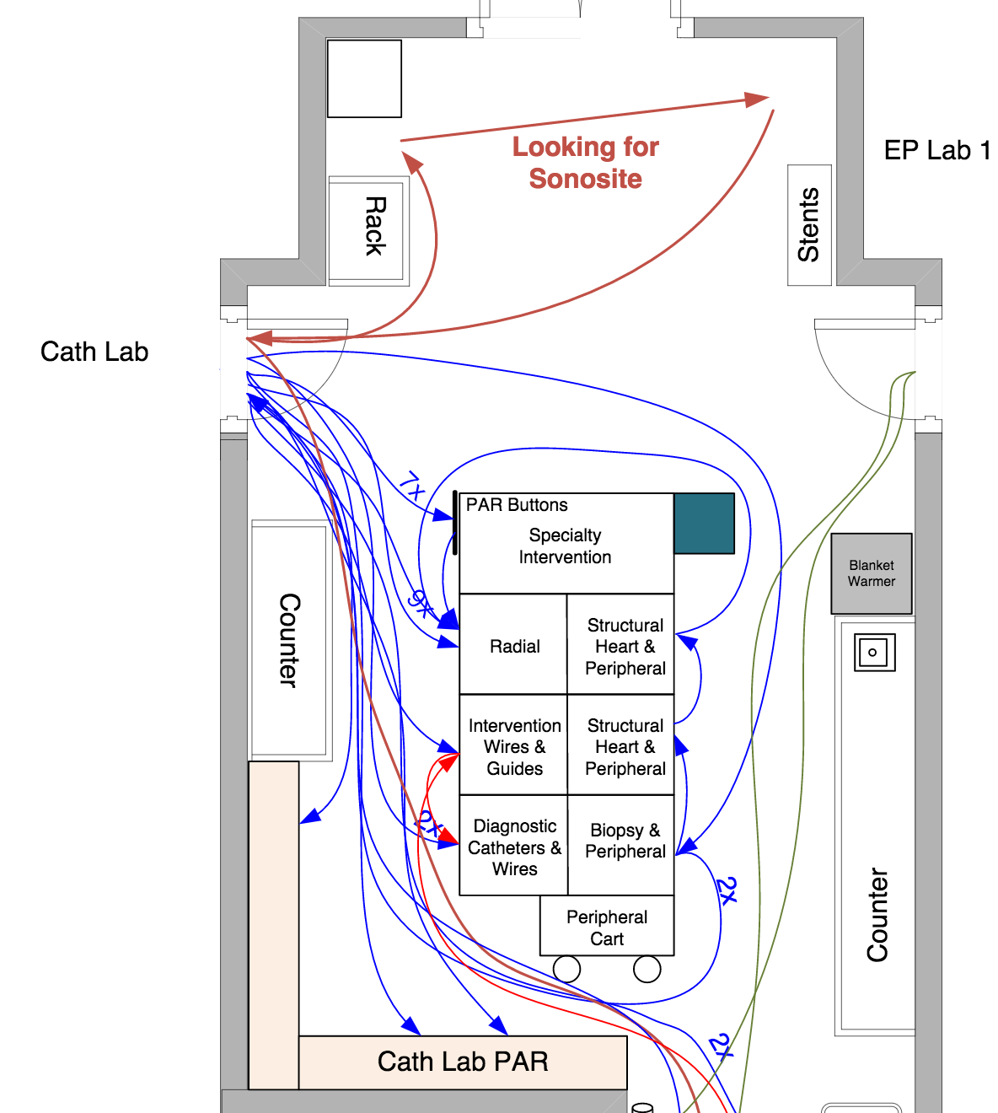
Spaghetti Diagram
Workbook, p. 75
Notes:
Make sure the volunteer who draws the spaghetti diagram understands how to draw the diagram – from a “bird’s eye view” of the room

Slide 12
ACTIVITY
Conduct an Emergency Department Simulation: Provide “care” (dots) to your “patients” (paper sheets) given your current environment – NO CHANGES ALLOWED
Follow Work Instructions
Goal: “Treat” as many patients as possible in the time given (5 MIN)
Debrief with the group
What you will need:
Table top signs (Workstations)
Work Instructions
Patients (Paper Sheets)
Dots (Care provided = Work)
Timer
Flip Chart
Markers
10 + 5 MIN
Notes:
ROOM SET UP
Set up room with 1, 2, or 3 simulations, 8 workstations each. Identify workstations with table top signs
With the first run of the simulation set up the workflow to be as difficult as possible, i.e. Place workstations not in order of numbers, 1 and 8 furthest apart, etc.
Put all supplies (dots) in store room
Put all patients (white sheets with open circles) in the waiting room

Slide 13
Metrics
TEAM | # of Patients Treated (Completed) | # Treated “Correctly” | # Patients in Process | Time to First Patient Completed
1
2
3

Slide 14
ACTIVITY
Conduct an Emergency Department Simulation: Provide “care” (dots) to your “patients” (paper sheets) given your current environment – NO CHANGES ALLOWED
Follow Work Instructions
Goal: “Treat” as many patients as possible in the time given (5 MIN)
Debrief with the group
What you will need:
Table top signs (Workstations)
Work Instructions
Patients (Paper Sheets)
Dots (Care provided = Work)
Timer
Flip Chart
Markers
10 + 5 MIN
Notes:
Key Debrief points:
Number of patients complete
Number of patients in process
Number of defects
Throughput Time
Debrief by asking
How did it feel?
What worked?
What didn’t work?
How could it be improved?

Slide 15
Debrief (Important Part of PDSA)
Act
Plan
How did it feel?
  to be the triage person? transport person? supply person?
What was the team work and communication like?
How do you think the patients felt?
What about the metrics?
How did we define Quality?
  Anyone notice there were dots outside of the circle?
  What did you do when you saw a quality issue?
  How was the training and instructions?
Study
Do

Slide 16
STUDY
This simulation will be repeated at the end of the day. The tools covered today will help you improve your process for a better patient outcome.
What will you do for your next PDSA?
  What are three options, based on the IHI courses, for your next PDSA?
Notes:
Answer: In IHI Course QI 103 - Adjust, Adopt or Discard

Slide 17
SESSION | Introductory Webinar | Smart Start: 2-Day On-Site | Learning Session #1 | Learning Session #2 | Learning Session #3
CONTENT | Quality Improvement Primer - Guiding Principles DMAIC Model for Improvement Data/ Measurement Overview Stakeholder Analysis Team Formation Planning for Smart Start / Process Mapping | DEFINE / MEASURE Process Mapping Brainstorming / Affinity Diagram Prioritize Opportunities for Improvement (OFIs) Impact/Effort Grid Project Outline Problem Statement Scope Aim Statement / Metric Elevator Speech Action Plan Communication Plan | Quality Improvement Review Smart Start Outputs PDCA Overview Project Mgmt. Change Mgmt. Voice of Customer Critical to Quality Data/Measurement ANALYZE 5 Whys, Cause & Effect Diagram, Pareto Diagram, Spaghetti Diagram, Run Charts/Control Charts | IMPROVE Simulation Before/After PDCA / Small Test of Change Lean 5S Visual Management Physical Layout Standardized Work Future State Process Map Data Display | CONTROL Process Owner Transfer Control Plan Result Communication Final Report Storyboard Presentation Spread Best Practices Celebrate Success Additional Tools Chart Review Avoiding Pitfalls

Slide 18
The Model for Improvement
3 Questions &
A Cycle (PDSA)
Workbook, p. 8-12

Slide 19
The Model for Improvement (IHI)
Aim
What are we trying to accomplish?
Measure
How will we know that a change is
an improvement?
Change
What change can we make that
will result in improvement?
Small tests of change
Act
Plan
Study
Do
Workbook, p. 8-9
Notes:
Improvement techniques are Formal methods to test changes in the steps of a process and seek to achieve greater process reliability more efficiently and at less cost
- Best to use an example like weight loss
- Reliable Process-a set of steps that when performed achieves the same result with minimum variation over time. The likelihood that a process will achieve its desired outcome is dependent on the variability of each step and the total number of steps. Reliability goes down as the number of steps increase and as the variability of the steps increases
- Test of Changes
- A test of change alters a step in a process and evaluates the impact of that alteration
- There are 3 questions to ask prior to a test of change or Plan, Do, Study Act PDSA
What are we trying to accomplish?
How will we know that a change is an improvement?
What change can we make that will result in improvements?
- PDSA’s don’t result in success or failure, they generate learning
- 4 components of PDSA
- Plan-develop an action plan to run the cycle. Predict the expected result. The who, what, where, and when. Keep it simple, only one change at a time, one shift, one day, etc.
- Do-perform the action plan
- Study-evaluate the change, and whether it performed as predicted
- Act-Reflect on what happened and use the learning to begin planning for the next test of change
- How to determine what test of changes to do
- First have a clear Aim, which means the team knows what to work towards
- Reflect on the major factors or drivers that will influence achieving the goal. This helps to focus the group’s efforts and decreases the likelihood that unnecessary work will occur
- Determining the major factors or drivers helps to limit the interventions or actions to the few that are most likely to help achieve the goal.
Plan
State the objective of the cycle, what are we trying to accomplish?
Make predictions
Generate solutions
Develop the plan to carry out the cycle (who, what, where, when)
Do
Test the change
Document problems and unexpected observations
Analysis the data
Study
Complete the analysis
Compare the data to predictions
Summarize learning's
Act
Make changes to the process
Standardize the process
Select the next cycle
What change can we make that will result in improvement?

Slide 20
The Model for Improvement
What are we trying to accomplish? | How will we know if a change is an improvement? | What change will we make that will result in an improvement?
Overarching Goal Improve the care & management for patients with high HIV viral load, specifically addressing the result reporting/clinician interpretation step of the viral load cascade | AIM Statement Increase the percentage of high viral load patients with documented appointment and timely clinical follow-up from 12% to 50% by 22 July 2016 (Short term aim = Follow-up appointment scheduled) from 50% to 80% by 31 October 2016 (Long term aim = Counseling and second viral load recorded) Metric: # of patients who meet follow-up criteria # patients with high viral load | NEW LOG / NEW PROCESS Track Handoffs and Clinical Actions related to High VL Test Results Appropriate Clinical Care for Patients

Slide 21
Test of Change = PDSA
A test of change alters a step in a process and evaluates the impact of that alteration
Workbook, p. 10-12

Slide 22
PDSA:
The Scientific Method of Improvement
The Scientific Method
  Create a hypothesis
  Perform an experiment
  Analyze the results
  Draw conclusions
Act
Plan
Study
Do

Slide 23

Discovery of the Structure of DNA
Hypothesis: Linus Pauling, Francis Crick and James D. Watson hypothesized that DNA had a helical structure.^{[41]}
Prediction: If DNA had a helical structure, its X-ray diffraction pattern would be X-shaped.^{[42][43]} This prediction was determined using the mathematics of the helix transform, which had been derived by Cochran, Crick and Vand^{[44]} (and independently by Stokes). This prediction was a mathematical construct, completely independent from the biological problem at hand.
Experiment: Rosalind Franklin crystallized pure DNA and performed X-ray diffraction to produce photo 51. The results showed an X-shape.
Analysis: When Watson saw the detailed diffraction pattern, he immediately recognized it as a helix

Slide 24
LEAN - PDSA
PDSA’s don’t result in success or failure,
they generate learning
ACT
PLAN
DO
STUDY
Workbook, p. 12
Notes:
PDSA’s don’t result in success or failure, they generate learning
4 components of PDSA
- Plan-develop an action plan to run the cycle. Predict the expected result. The who, what, where, and when. Keep it simple, only one change at a time, one shift, one day, etc.
- Do-perform the action plan
- Study-evaluate the change, and whether it performed as predicted
- Act-Reflect on what happened and use the learning to begin planning for the next test of change

Slide 25
Selecting the change:
How to determine what test of changes to do
CHANGE
Have a
Clear Aim
Understand Root Cause
Research
(Evidence-based changes)
Brainstorm
Experience
Listen to Voice of Customer
Notes:
- How to determine what test of changes to do
- First have a clear Aim, which means the team knows what to work towards
- Reflect on the major factors or drivers that will influence achieving the goal. This helps to focus the group’s efforts and decreases the likelihood that unnecessary work will occur
- Determining the major factors or drivers helps to limit the interventions or actions to the few that are most likely to help achieve the goal.

Slide 26
Let’s Lose Weight
Where to start?
Notes:
Create a realistic example of a weight loss PDSA on a flip chart – encourage audience participation

Slide 27
QI 102: Lesson 5
Once a team has set an aim (Lesson 2), developed measures to determine whether a change leads to an improvement (Lesson 3), and come up with some good ideas for changes (Lesson 4), the next step is to test the idea for a change. The PDSA cycle is a great way to test a change — by planning it, trying the plan, observing the results, and acting on the learning from the results.
ACT
PLAN
DO
STUDY
Notes:
Walk through a weight loss PDSA, such as:
What are you trying to accomplish? Weight loss
How will you know…? Metric = weight → Aim: (p. 14 in Workbook) Decrease weight by 2 lbs. by 1 week.
What changes…? Make a list; it may include diet, exercise, record food intake, crazy diets, etc.
Tests of change:
Plan: Select one, How sill you implement; How will you measure, when, where, who?
Do: for 1 week
Study: Compare your prediction with what actually happened
Act: Adopt, Abandon, or Adapt

Slide 28
Small Tests of Change (PDSA)
1:1:1 Rule
5X Rule
ACT
PLAN
DO
STUDY

Slide 29
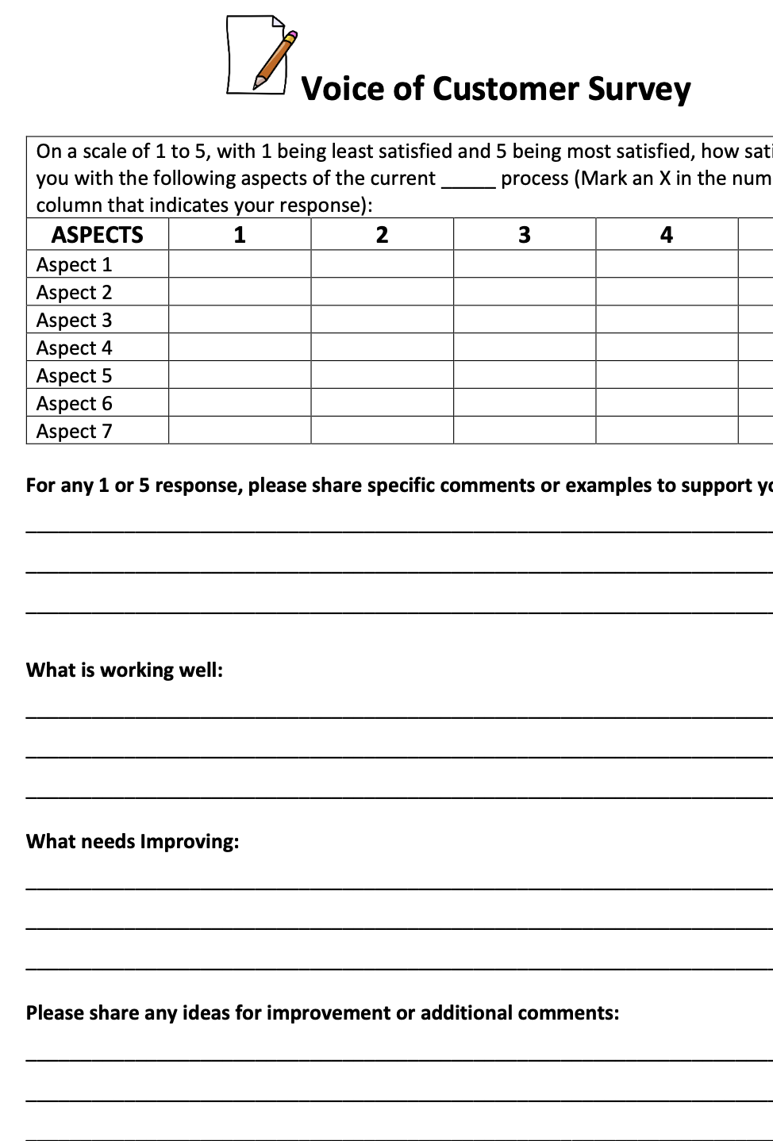
Let’s Design a VOC Survey
How would you use the 1:1:1 Rule?
Notes:
3 Questions:
Accomplish? Learn what is important to your customer
How will you know…? Measure satisfaction score; Aim: Find out if it is user friendly? Are you getting the information you need? Qualitative data
What changes…? Change language, administer with assistance, questions were to vague, not questions where you can get a numeric score
Why small test? Not large investment before you find out it does not work,

Slide 30
PDSA - Small Test of Chance (July)
ACT
PLAN
DO
CHECK
Worked well ➡️ Standardize
Did not work ➡️ Create new test of change (PDCA)
Worked partially ➡️ “Tweak” and begin PDCA #2
⬆ % of high VL patients scheduled for F/U appointment from ___ to 50%
Analyze Data (by 29 July)
  Met goal?
  Why/Why not?
Test new Daily High VL Tracking Log on Tuesdays & Thursdays 12-22 July
Notes:
Adapt, Accept, or Abandon
3 Basic PDSA Principles
Test on a small scale and build knowledge sequentially
Collect data over time and display it
Include a wide range of conditions in latter test cycles

Slide 31
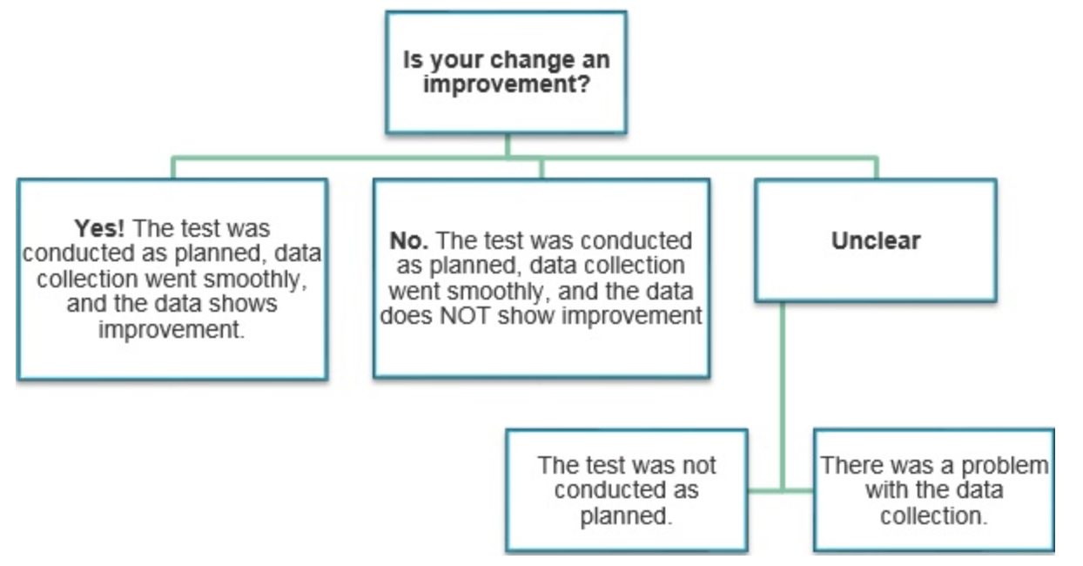
Evaluating PDSAs

Slide 32
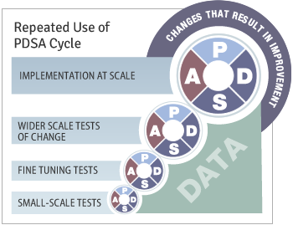
PDSA – Not one and done!

Slide 33

LEAN
Eliminate Waste
Workbook, p. 68-75
Notes:
Like its name sounds, it’s a way to slim down our processes by eliminating waste, variation and imbalance
Note examples of waste, variation and imbalance in the recent exercise.
Our goal is to create value end to end in the process.
Lean - Improving Workflow,
Removing Non-Value Added Aspects
Lean and Six Sigma are complementary philosophies.
The difference in lean and Six Sigma lie primarily in the focus. The elimination of waste with lean is fairly similar to the reduction of variation in Six Sigma. However, Lean’s focus on improving workflow is perhaps the main differentiator. By focusing on the workflow, lean efforts ensure that non-value-adding aspects are removed from the value stream.
Lean efforts help make sure that we are doing the right things. Six sigma initiatives help make sure we are doing the right things right.
Lean: Background
Lean: Background
•
1913: Henry Ford’s breakthrough thinking
•
1942: Training within industry (war effort)
•
1947-80: Toyota Production System
•
1990: Term coined in 1990 best-seller The
Machine That Changed The World
(author = Womack)
•
2000: Lean Enterprise, Service &
Health Care
•
Lean Thinking
Principles
1. Define value from perspective of end
customer
2. Identify the value stream(s) and highlight
waste
3. Understand what drives the waste
4. Eliminate all the waste that one can
5. Make the remaining value-creating steps flow
6. Pursue perfection
Lean works in
all industries, all functions, anywhere
there is an activity
.

Slide 34
Lean Simplified
Streamline the Value Stream (Work or Process Flows & Layouts)
Pull vs Push
Predictability & Consistency (Quality) – e.g. Mistake Proofing
Workplace organization (5S)
Visual Workplace (Visual Management)
Continuous Improvement (PDSA)

Slide 35
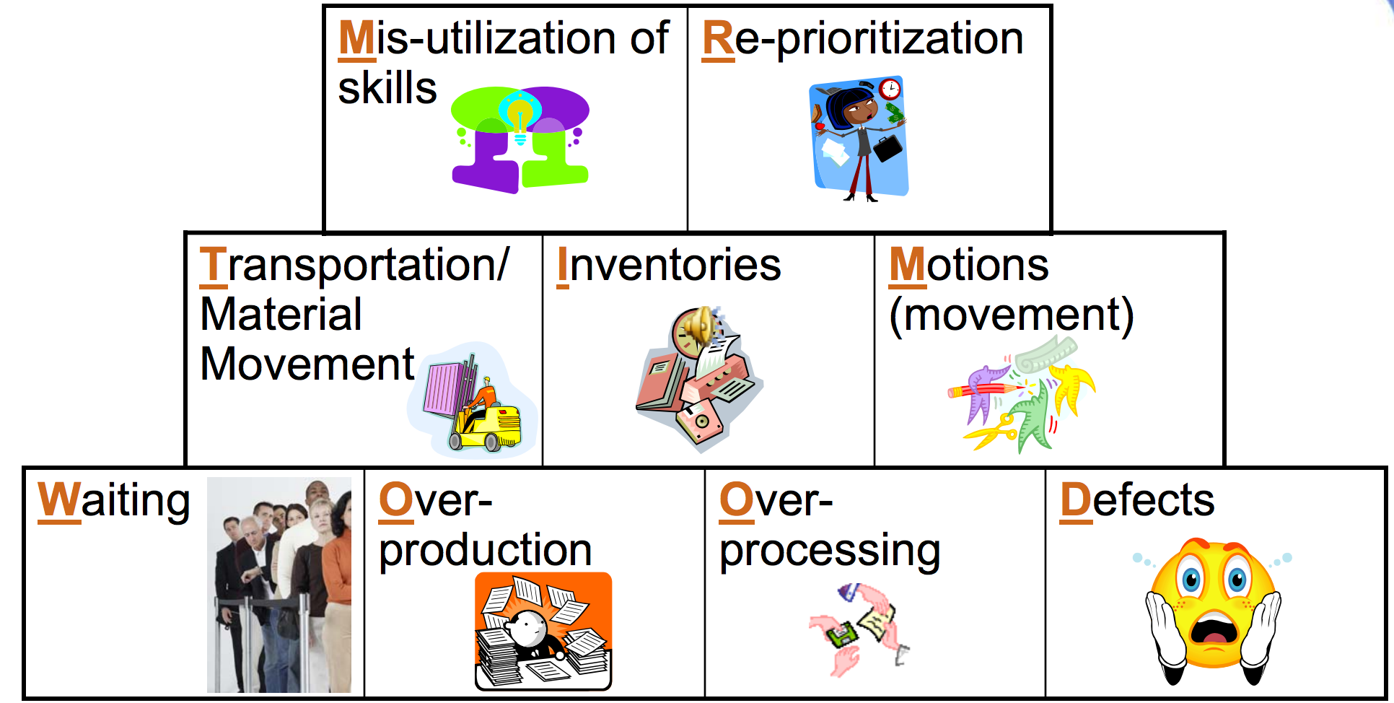
Types of Waste – MR TIM WOOD
Notes:
Elimination of waste starts with identification of waste.
Anything that does not add value is classified as waste.
Identification of waste may require a change in thinking.
Revisit the why’s of every process step. Is it really necessary?
Some activities and process outputs seem necessary to meet internal standards, but are they necessary to the external customer?
Waste can be considered as any activity or resource in an organization that does not add valued to an external customer.
M - Mis-utilization of skills: Not taking advantage of people’s expertise, improvement ideas not listened to or acted upon; Under utilizing capabilities, delegating tasks with inadequate training
R - Reprioritization: Stat orders, phone calls, trouble shooting, emails, IM pop ups
T – Transport – Moving people, products & information; Moving patient records or films to another area; going to get signatures
I – Inventory – Storing parts, pieces, documentation ahead of requirements; Pharmacy stock, lab supplies, office supplies
M – Motion – Bending, turning, reaching, lifting; Searching for patients; searching for medications, searching for charts, searching for files; moving patients for testing
W – Waiting – For parts, information, instructions, equipment; waiting for bed assignments, discharge, approvals
O – Over production – Making more than is IMMEDIATELY required; Medication given early to suit staff schedules, testing ahead of time to suit lab schedule, making extra copies
O – Over processing – Tighter tolerances or higher grade materials than are necessary; Multiple bed moves, extra paperwork, excessive reviews/analysis, creating reports no one uses/reads, use of out-dated forms
D – Defects – Rework, scrap, incorrect documentation; Medication errors, improper diagnosis, patient complaints, data entry error, pricing error, mislabeled specimen.

Slide 36
ACTIVITY
Conduct a “Waste Walk”: Identify the Waste in the ER Exercise
Using the 9 categories of waste as a guide, identify specific episodes of waste that you experienced during the ER exercise & create a list
Debrief with the Group
Group Work at Team Table
7 MIN
Workbook, p. 70
Notes:
Say: The first and easiest Lean tool you can start using immediately is a waste walk. A waste walk is an opportunity to look at your process with a completely different perspective.
Simply stated, you observe the process while at the same time documenting any examples or occurrences of the 9 types of waste we just reviewed. The handouts contain a template for taking a waste walk.
To demonstrate, I’d like you to take 5 minutes as a table and do a mental “waste walk” based on the ER exercise you just completed for the 1st round of the Dot Exercise.
As the class is discussing, list the 9 wastes on a flip chart. After 5 minutes, poll the class for some of their responses for each type of waste and write it next to each waste category on the flip chart.

Slide 37
ACTIVITY
Conduct a “Waste Walk”: Identify the Waste in the ER Exercise
Using the 9 categories of waste as a guide, write (sticky notes) the specific episodes of waste that you experienced during the ER exercise
Place on flip chart - under appropriate categories
Debrief with the Group
What you will need:
Sticky Notes
Markers
7 MIN
Workbook, p. 70
Notes:
Say: The first and easiest Lean tool you can start using immediately is a waste walk. A waste walk is an opportunity to look at your process with a completely different perspective.
Simply stated, you observe the process while at the same time documenting any examples or occurrences of the 9 types of waste we just reviewed. The handouts contain a template for taking a waste walk.
To demonstrate, I’d like you to take 5 minutes as a table and do a mental “waste walk” based on the ER exercise you just completed for the 1st round of the Dot Exercise.
As the class is discussing, list the 9 wastes on a flip chart. After 5 minutes, poll the class for some of their responses for each type of waste and write it next to each waste category on the flip chart.

Slide 38
Lean Simplified
Streamline the Value Stream (Work or Process Flows & Layouts)
Pull versus Push
Predictability & Consistency (Quality) – e.g. Mistake Proofing
Workplace organization (5S)
Visual Workplace
Continuous Improvement (PDSA)

Slide 39
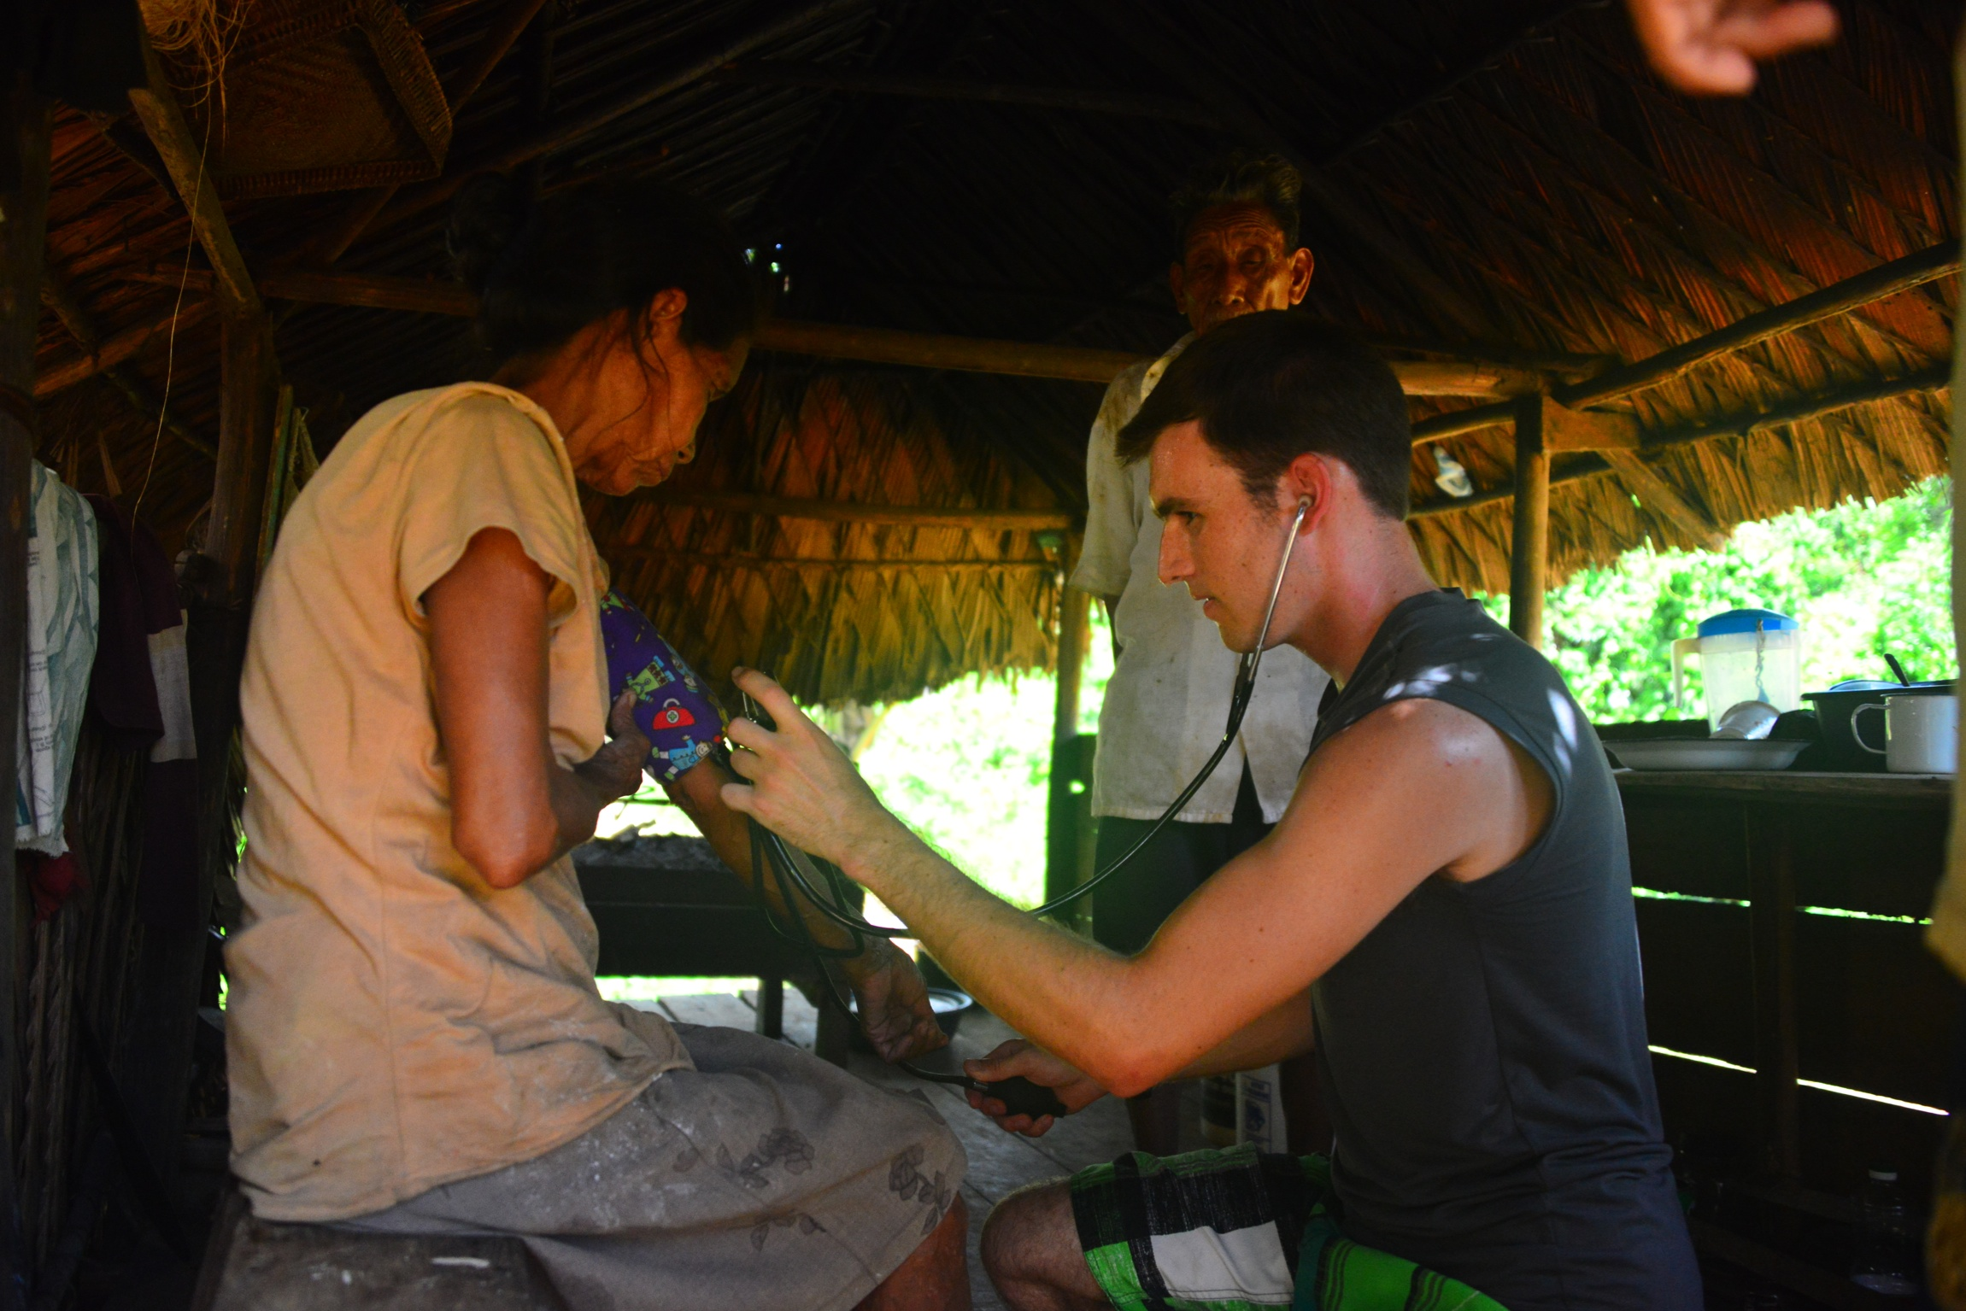
Value
Define value in your process through the eyes of the patient

Slide 40
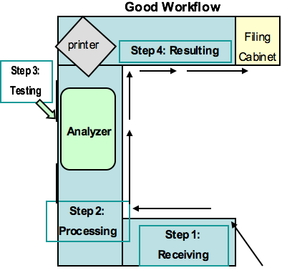
P + S = O
Process Flow
Layout
Notes:
Process flow and layout are at the heart of lean manufacturing.
In all cases, the flow patterns arrange the process steps in a natural flow order, link process steps to minimize cycle time and travel distance, eliminate crossover points, and simulate a continuous flow process by putting internal customers and suppliers next to each other.

Slide 41

Value Added Ratio
Process Time (Value Added)
Total Time
Notes:
Using the ED Simulation, Calculate the value added ratio, find the bottle neck

Slide 42
Process Map – Future State
Workbook, p. 38-41

Slide 43
Moving from Current State to Future State
Eliminate unnecessary steps
Combine steps when practical
Re-arrange steps for a better sequence
Simplify necessary steps
Work out your ideas with others
Create a new (future state) process map

Slide 44
Process Map –
BEFORE or Current State

Slide 45
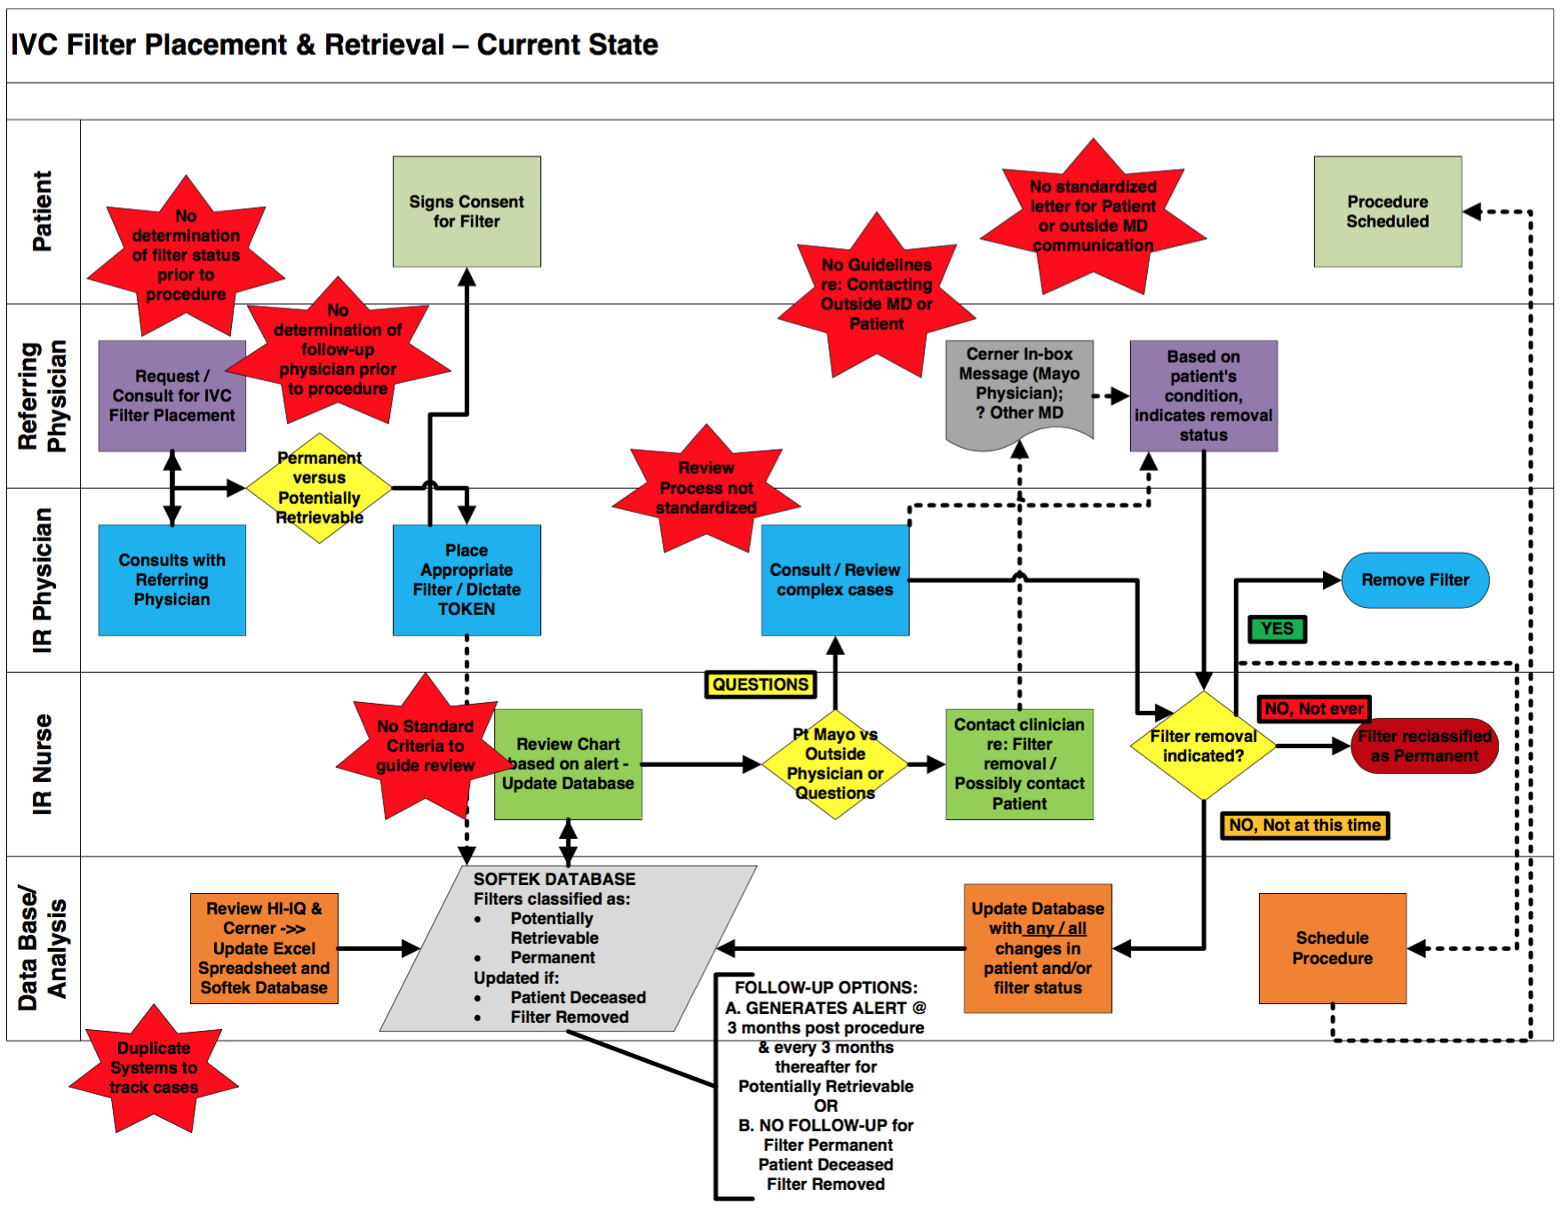
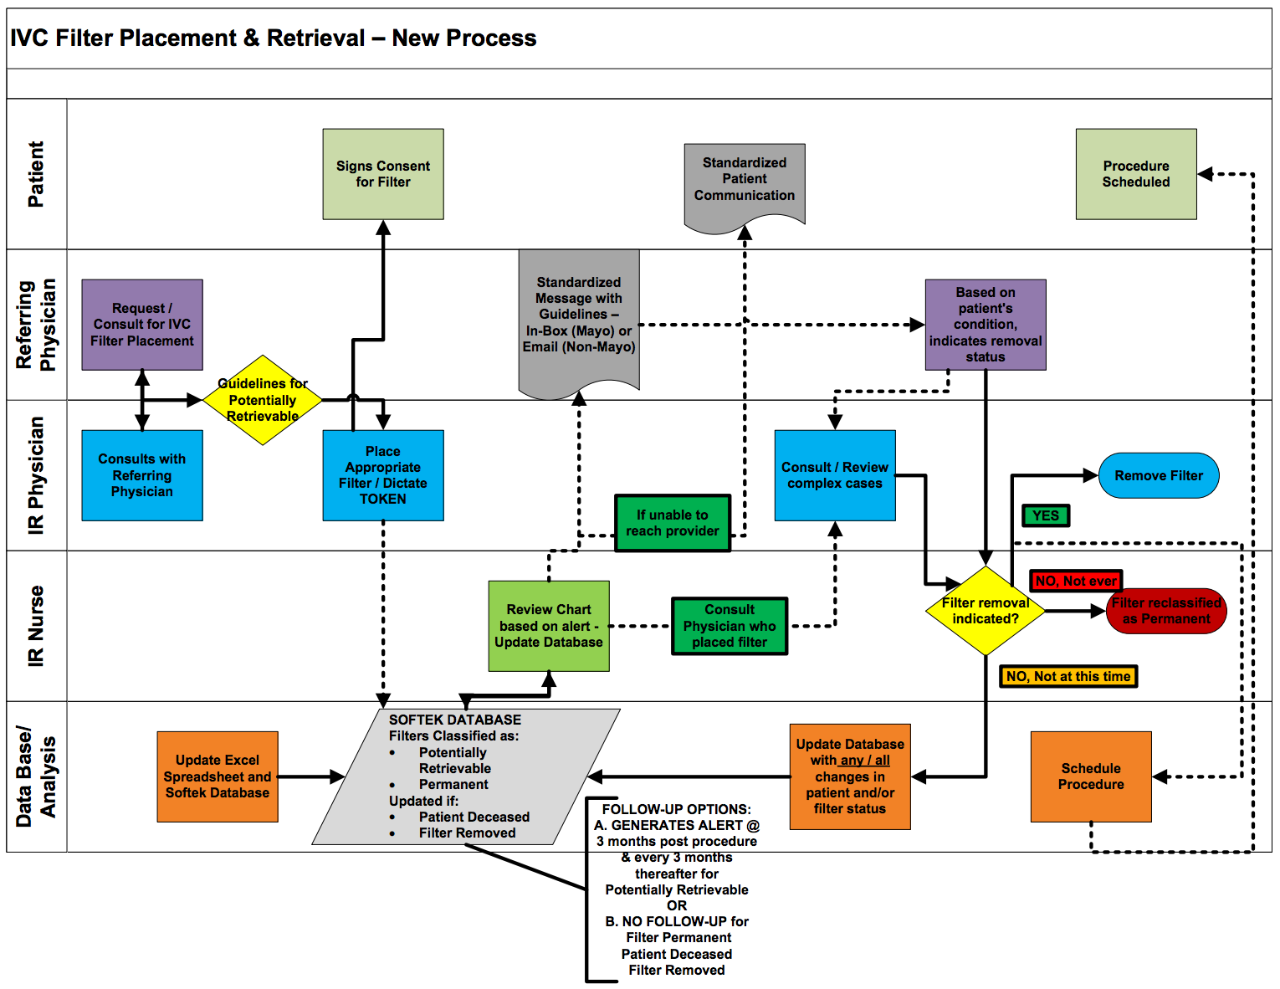
Process Maps
Current State
Future State

Slide 46



Process Map –
AFTER or Future State
DATABASE
IR Nurse Reviews every 3 months
Message to Primary Provider Re: Follow-up
Consults with IR provider
Filter Retrieved by IR if indicated

Slide 47
Lean Simplified
Streamline the Value Stream (Work or Process Flows & Layouts)
Pull vs Push
Predictability & Consistency (Quality) – e.g. Mistake Proofing
Workplace organization (5S)
Visual Workplace (Visual Management)
Continuous Improvement (PDSA)

Slide 48
Lean Simplified
Streamline the Value Stream (Work or Process Flows & Layouts)
Pull vs Push
Predictability & Consistency (Quality) – e.g. Mistake Proofing
Workplace organization (5S)
Visual Workplace (Visual Management)
Continuous Improvement (PDSA)

Slide 49
Let’s talk about standardization…
How important is standardization to implementing improvement?
Workbook, p. 76

Slide 50
ACTIVITY
Standardization
Given a set of Lego blocks, build a car
Work together as a team
When time is up, bring your team’s work product to the front of the room
Compare the cars between all teams
Debrief
What you will need:
For each team:
A set of Lego blocks
15 MINs

Slide 51

Which team’s Lego blocks look like a car?

Slide 52
ACTIVITY
Standardization
Given a set of Lego blocks, build a car
Work together as a team
When time is up, bring your team’s work product to the front of the room
Compare the cars between all teams
Debrief
What you will need:
For each team:
A set of Lego blocks
15 MINs
Notes:
Debrief Key Points:
Which teams actually made a car? Why?
Did having the work instructions make a difference?

Slide 53
Standard Work
An important part of change
After you have
  DEFINE - the problem
  MEASURE - Select a measure, collect baseline data & ongoing data
  ANALYZE – Find the root cause
  IMPROVE – Multiple PDCAs, Selected the change
Now, how do you make the change become standard work?
Workbook, p. 76

Slide 54
ACTIVITY
Implementing Standard Work
Watch the video of the ‘improved’ process (the change)
Working as a team, create clear, easy to use standard work instructions
Bring your team’s work instructions to the front of the room
Compare the standard work instructions between all teams
Debrief
What you will need:
For each team:
Flip Chart
Markers
15 MINs

Slide 55

Video: How to Fold a T-shirt

Slide 56
ACTIVITY
Implementing Standard Work
Watch the video of the ‘improved’ process (the change)
Working as a team, create the standard work instructions
Bring your team’s work instructions to the front of the room
Compare the standard work instructions between all teams
Debrief
What you will need:
For each team:
Flip Chart
Markers
15 MINs

Slide 57
Examples of SOPs

Slide 58
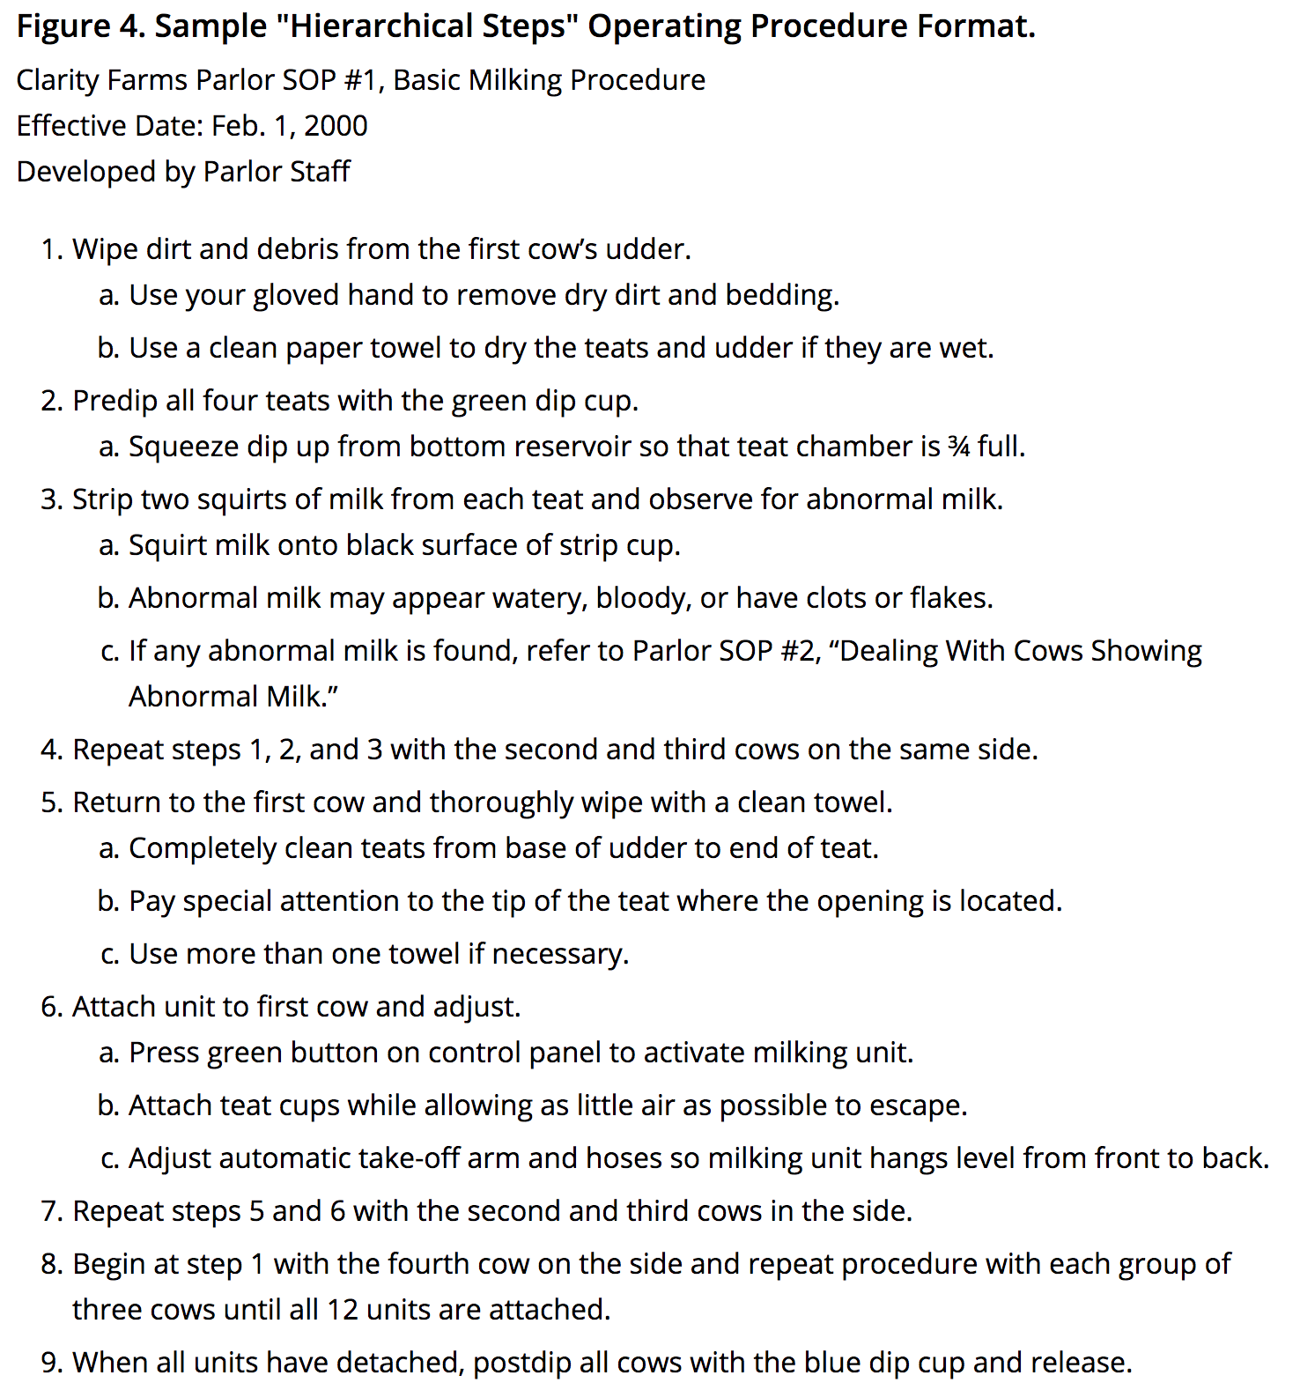
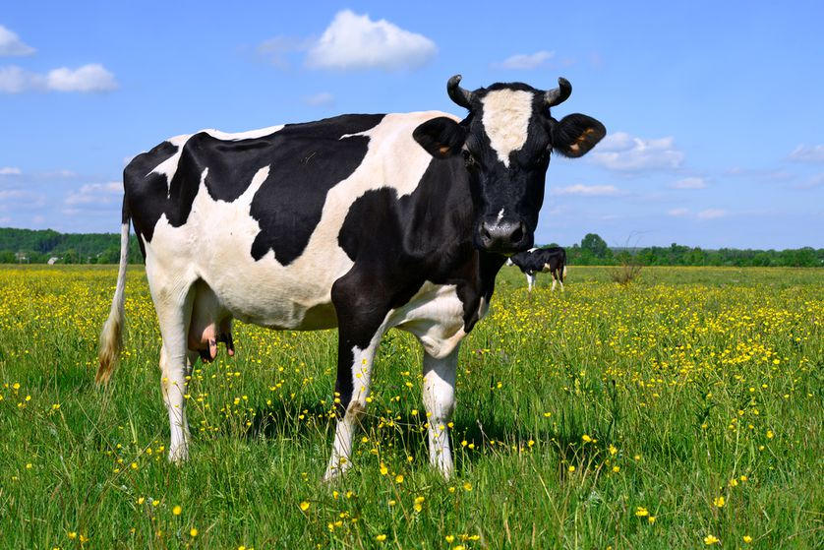
Communicating Standard Work
Simple or Hierarchical Steps

Slide 59
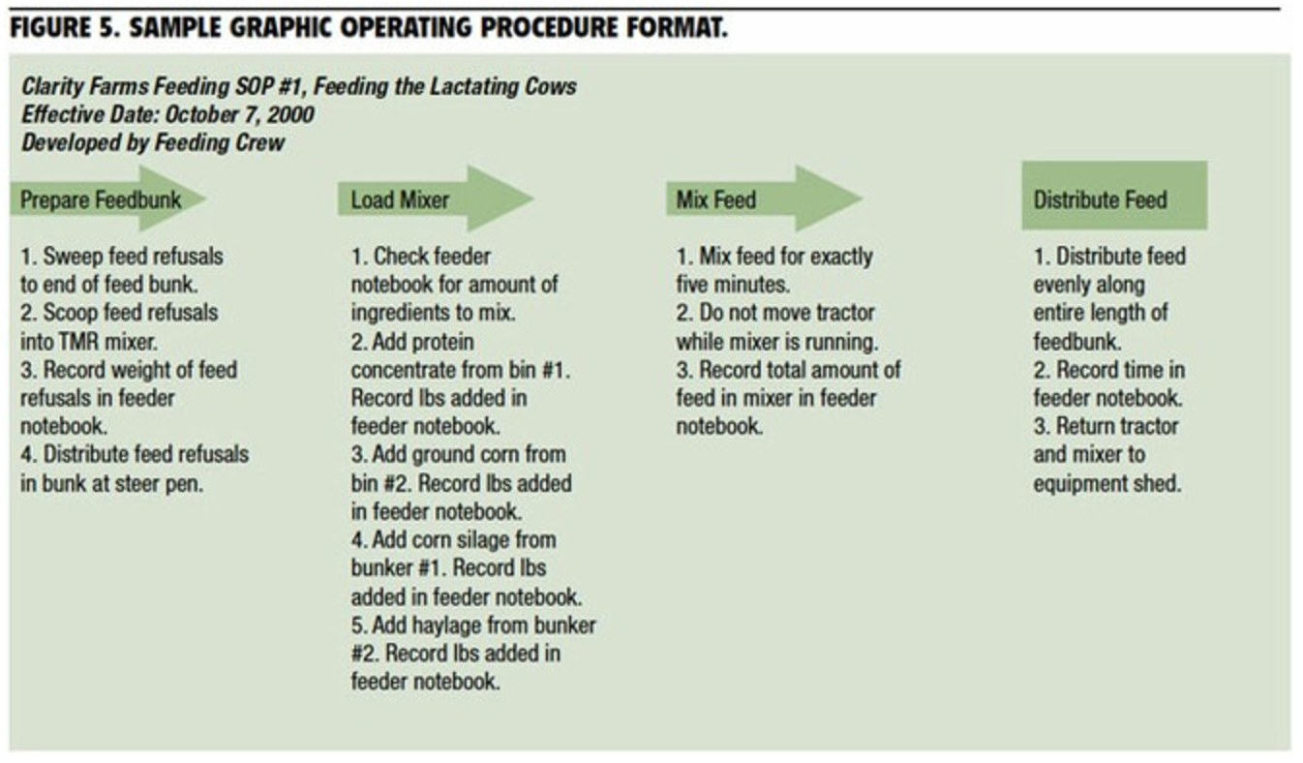
Communicating Standard Work
Graphic Procedures

Slide 60

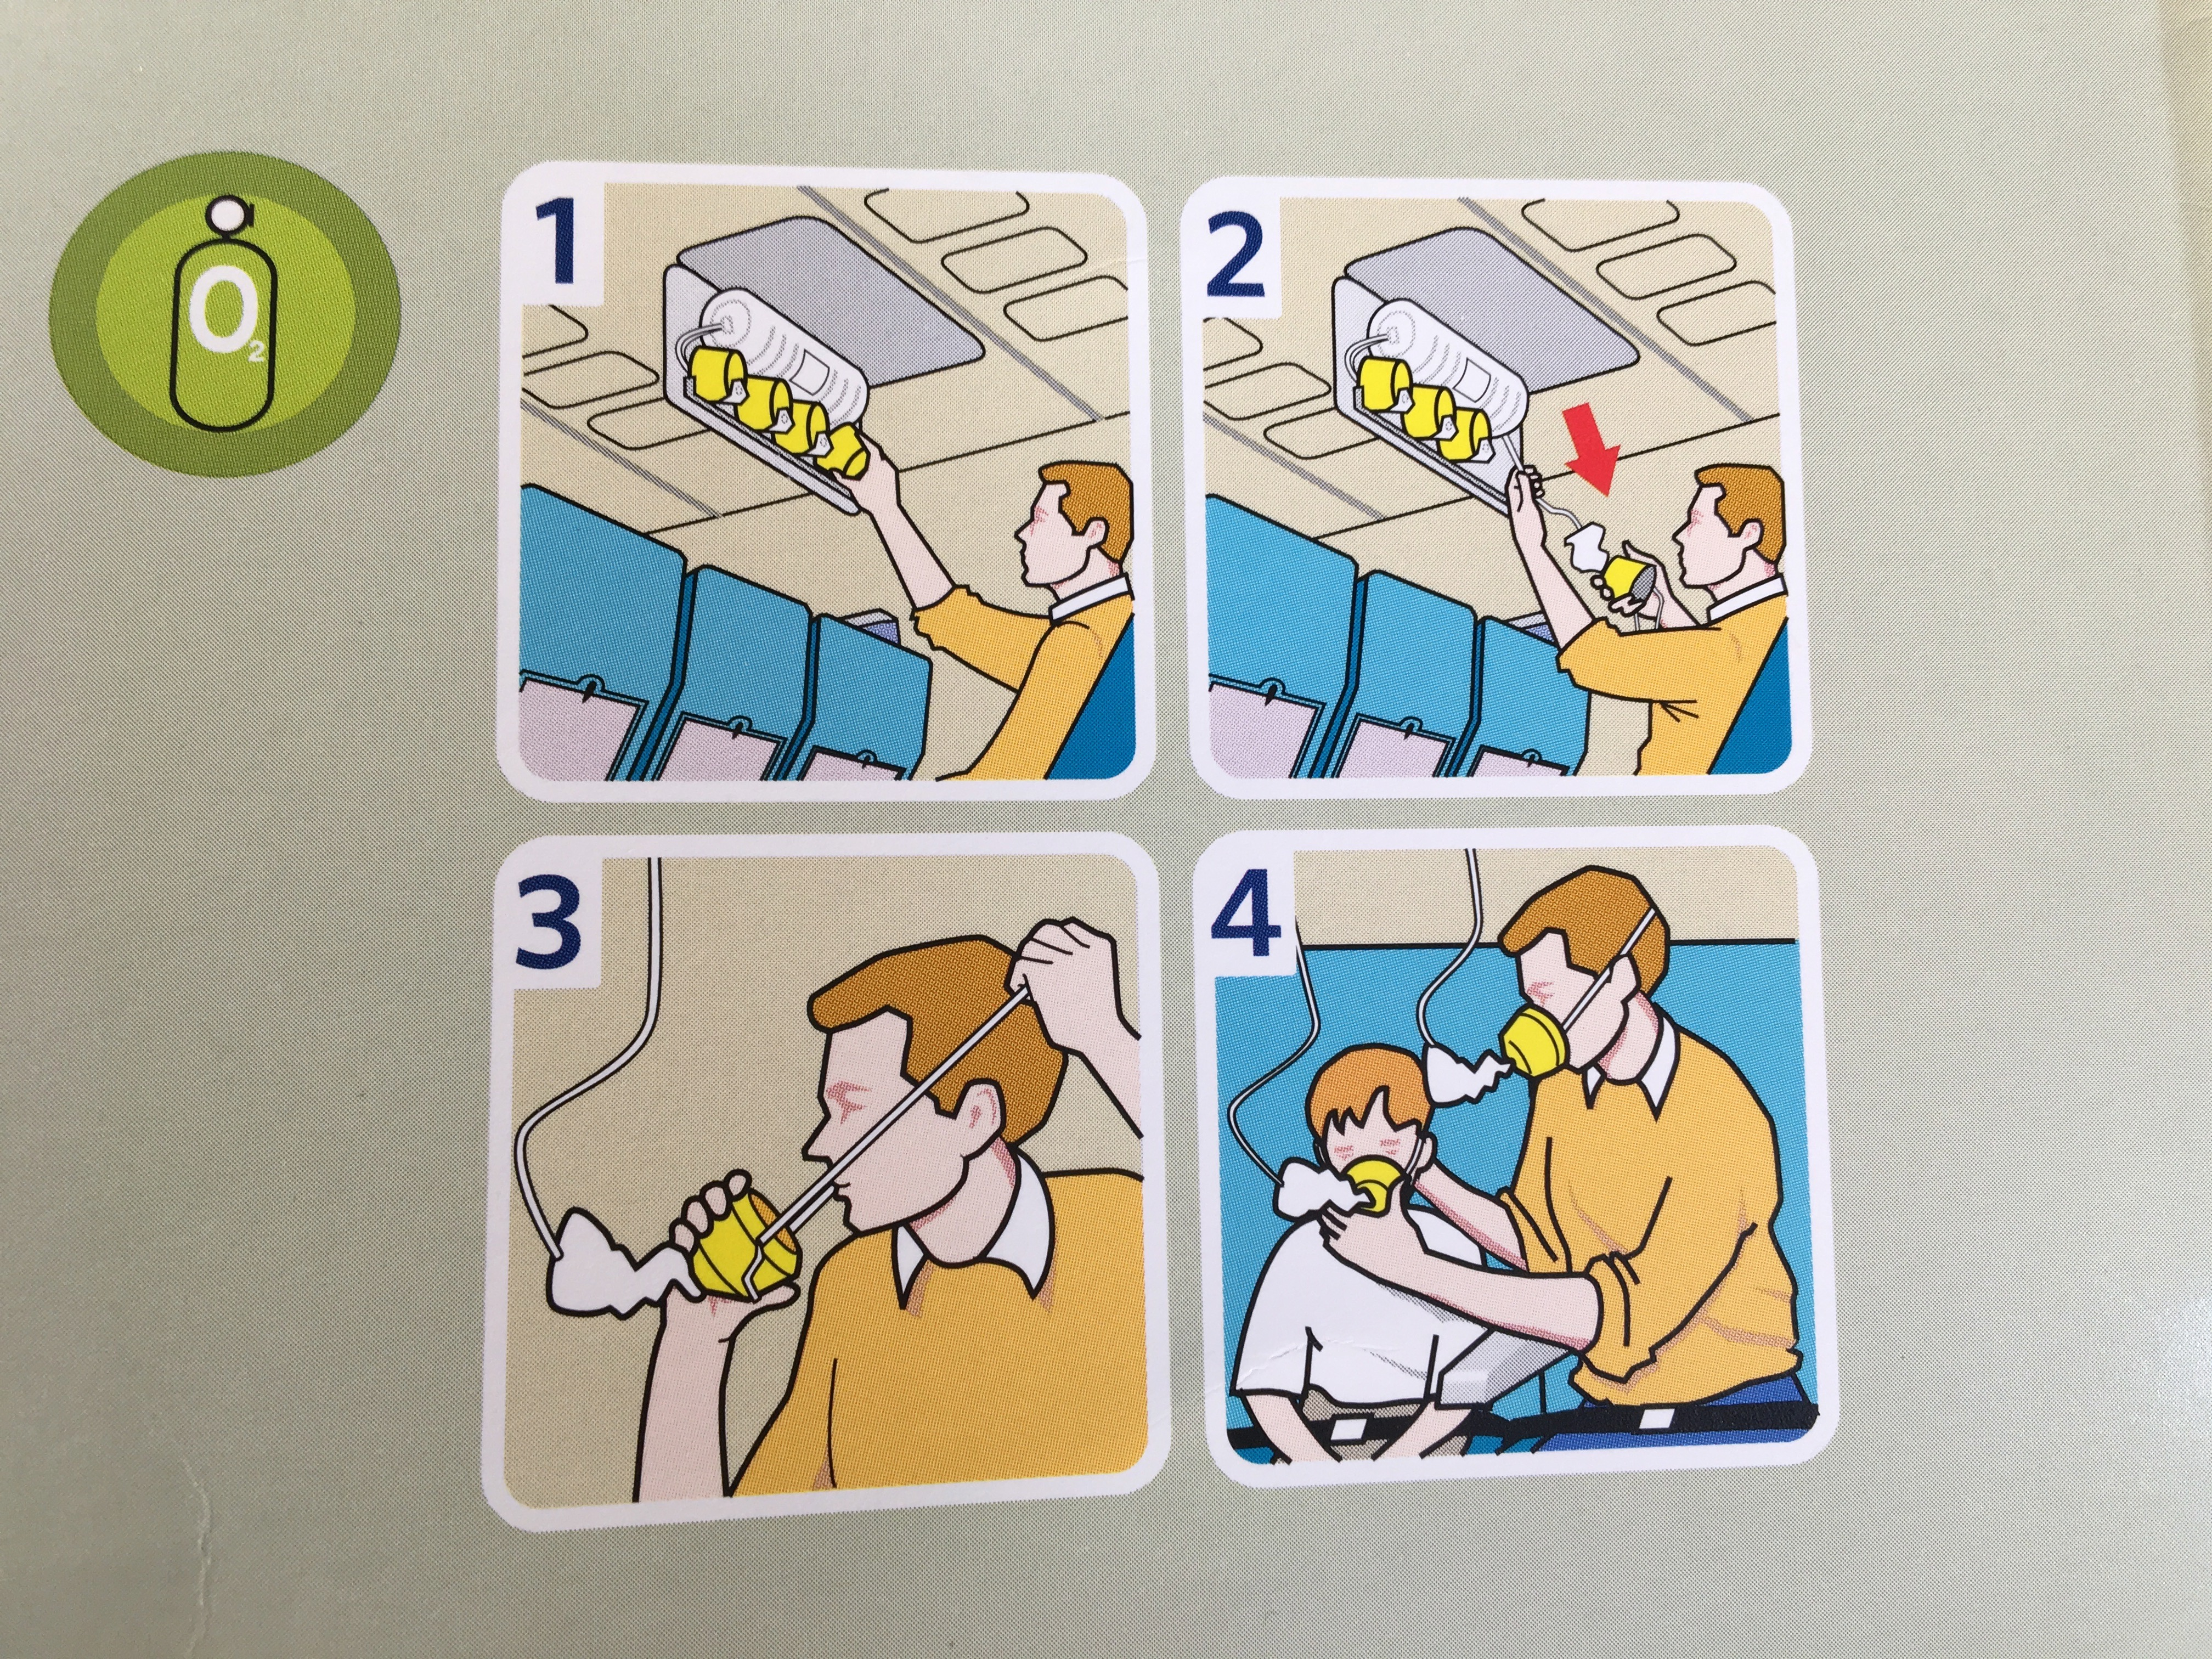
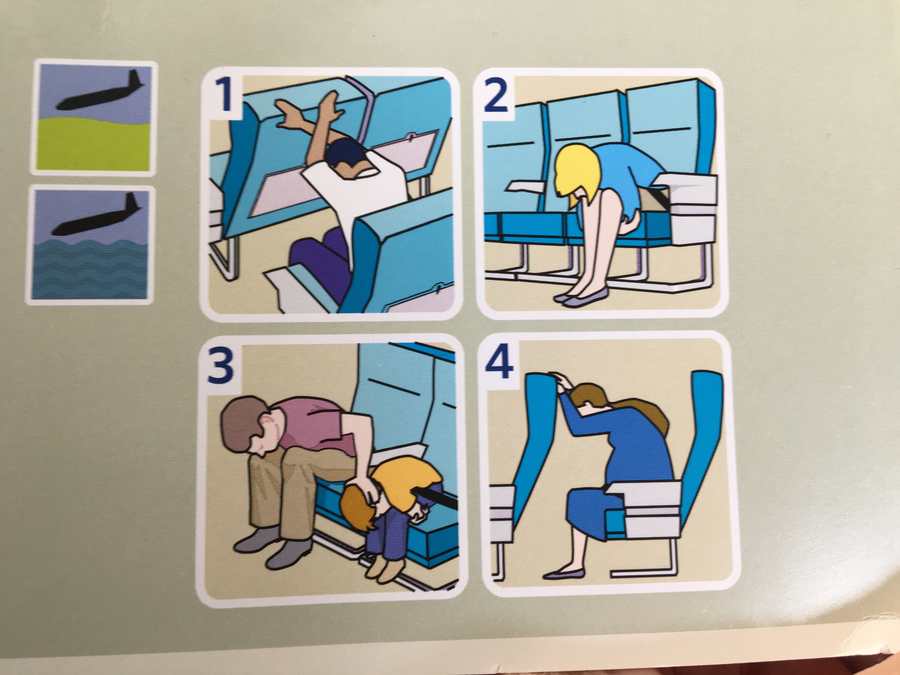
Communicating Standard Work
Graphic Procedures

Slide 61
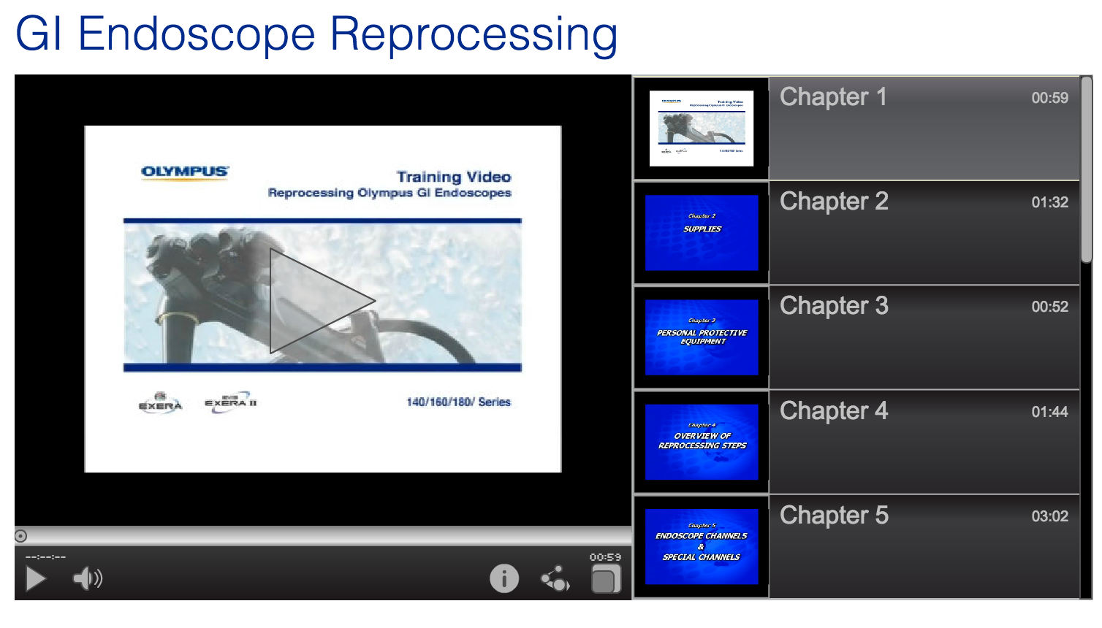
Communicating Standard Work
Graphic Procedures - Video

Slide 62

Communicating Standard Work
Written Manual
111 Pages

Slide 63
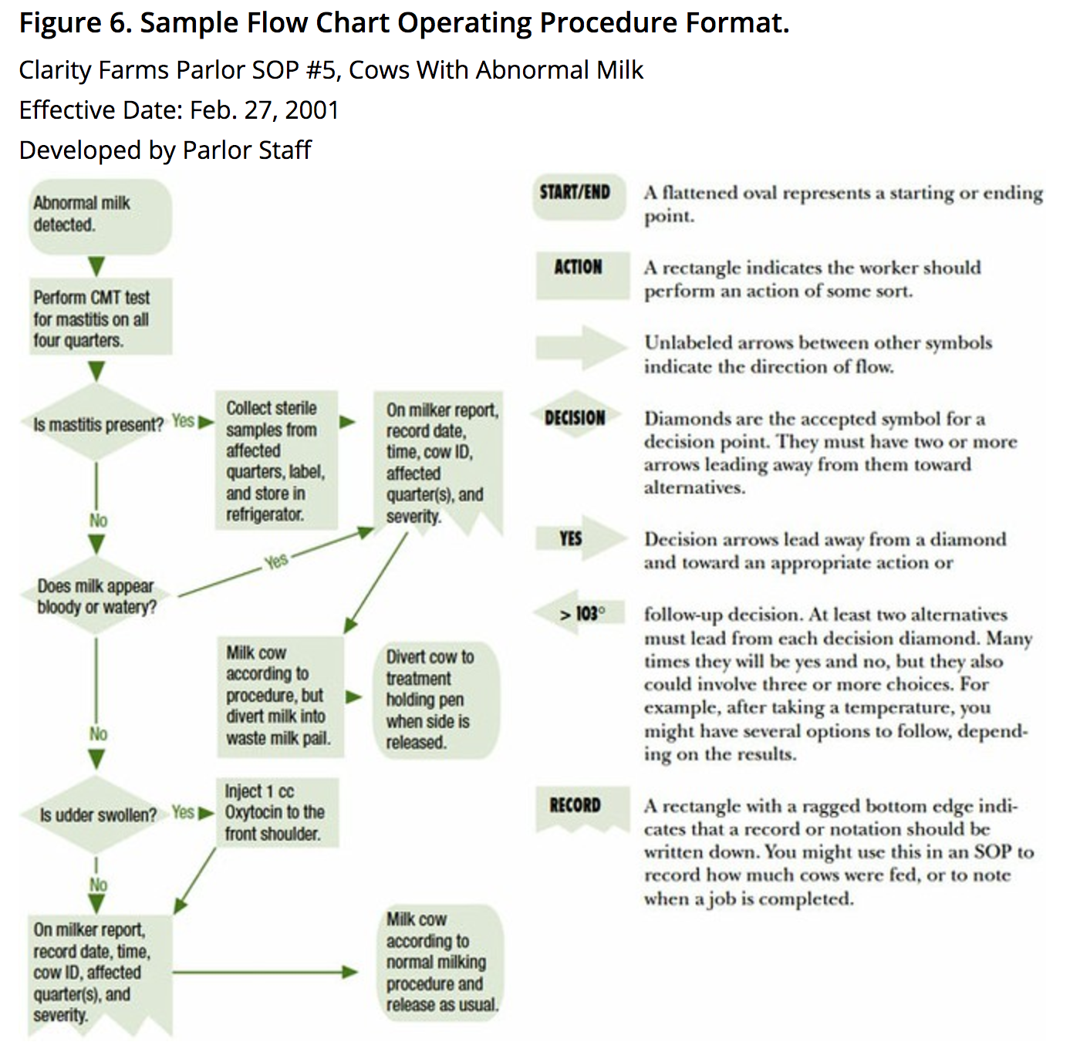
Communicating Standard Work
Flowcharts

Slide 64
For discussion
Why is standard work important?
When might you choose to use one form of communication of standard work over another?

Slide 65
Lean Simplified
Streamline the Value Stream (Work or Flows & Layouts)
Pull versus Push
Predictability & Consistency (Quality) – e.g. Mistake Proofing
Workplace organization (5S)
Visual Workplace (Visual Management)
Continuous Improvement (PDSA)

Slide 66
LEAN - 5S Exercise
Workbook, p. 71-73

Slide 67
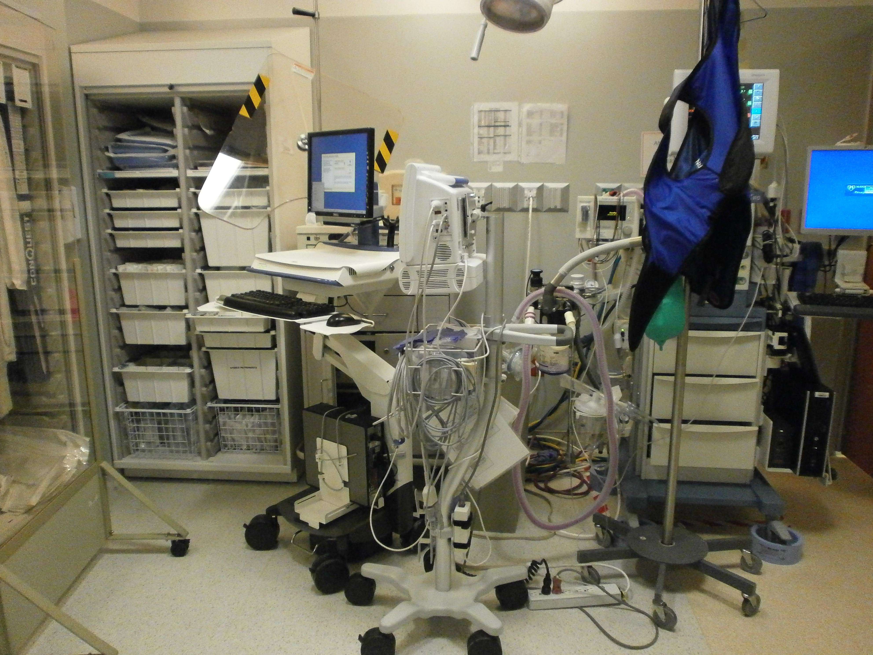
If you are here…

Slide 68
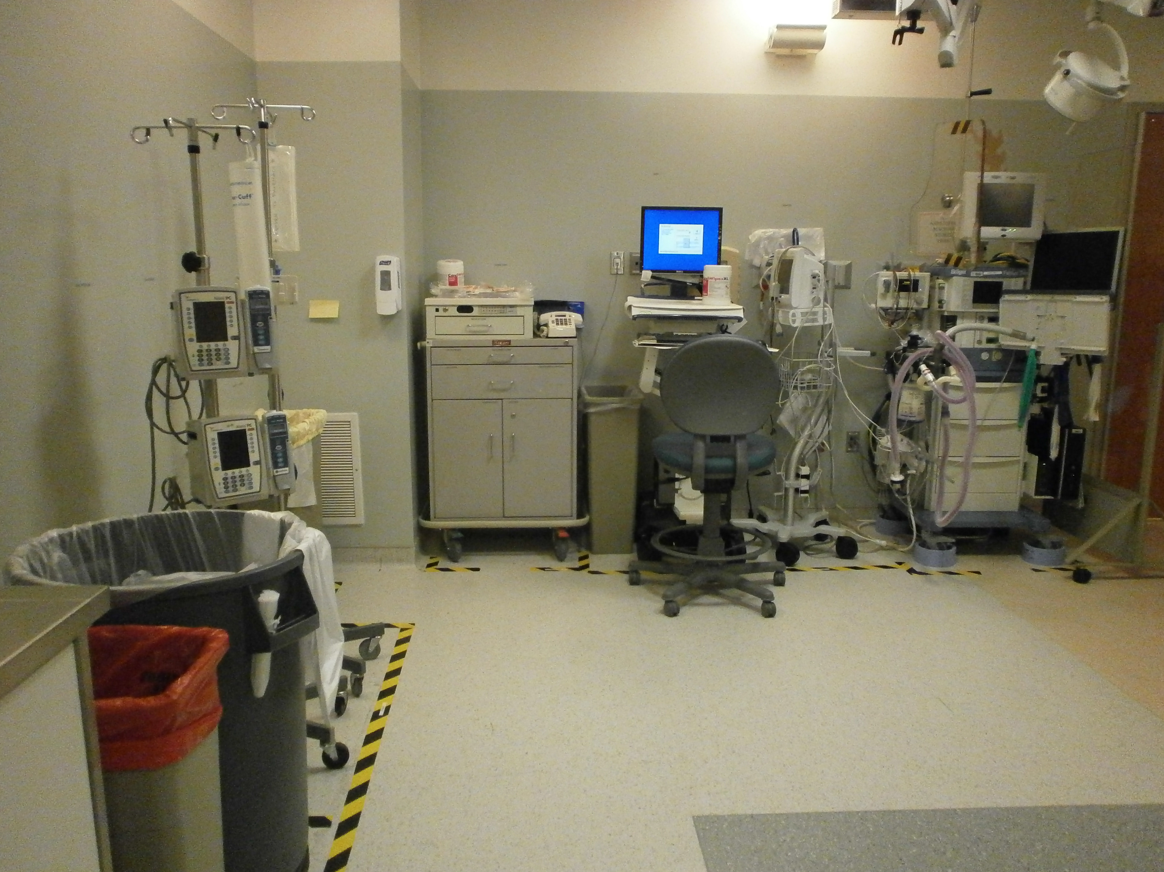
But you want to be here…

Slide 69


5S is the tool for you!
Before
After

Slide 70
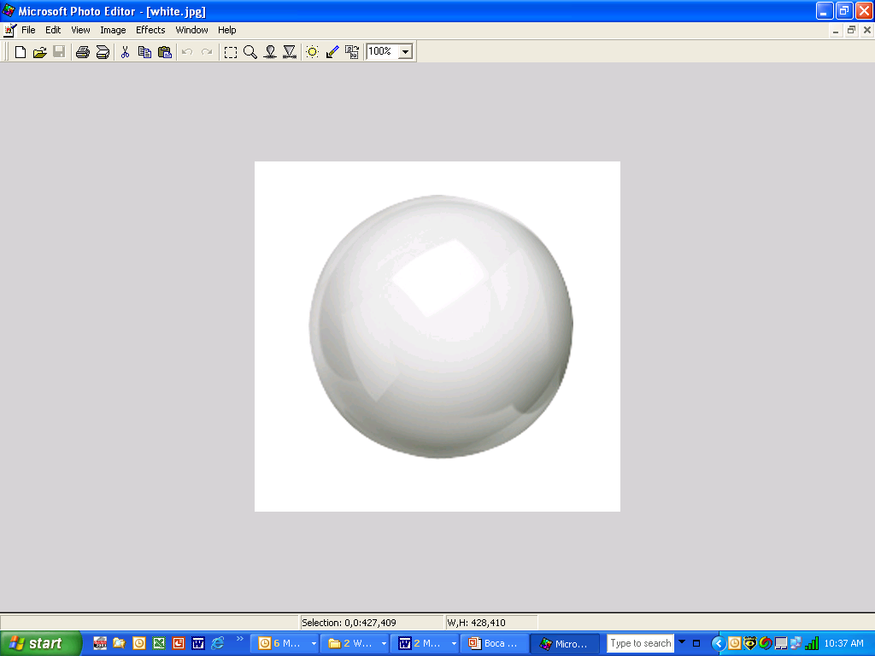

Sort
Needed items from the un-needed
Set In
Order
Efficient access and identification
5S
Shine
Area is clean and everything is maintained
Standardize
Consistent guidelines, visual indicators
Education, communication, and continual improvement. Until it becomes a habit!
Sustain
Notes:
70
Say: And here is a description of the workplace using 5S. There are 5 steps in this process.
TEST Q: Sorting through and getting rid of unneeded items (waste)
Setting what’s left in order so it can be seen and reached
Making the area clean and shiny
TEST Q: Standardization: Creating ways to do this in a standard way going forward. Taking the guess work out.
And finally…
Creating a driving force to make sure we sustain the work that was done. This is the hard part!

Slide 71
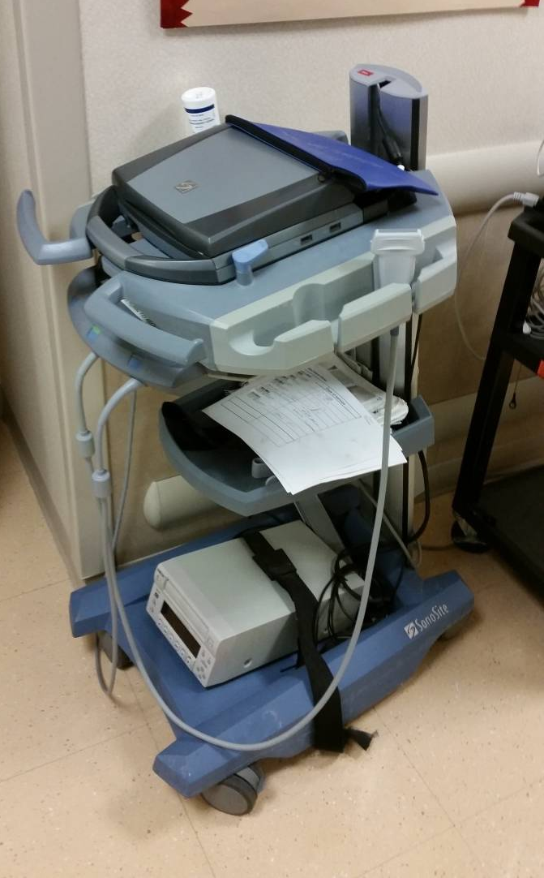
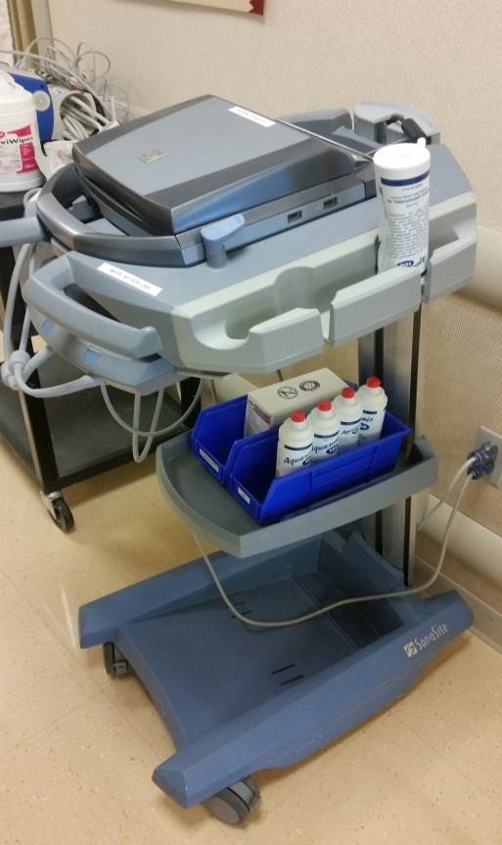
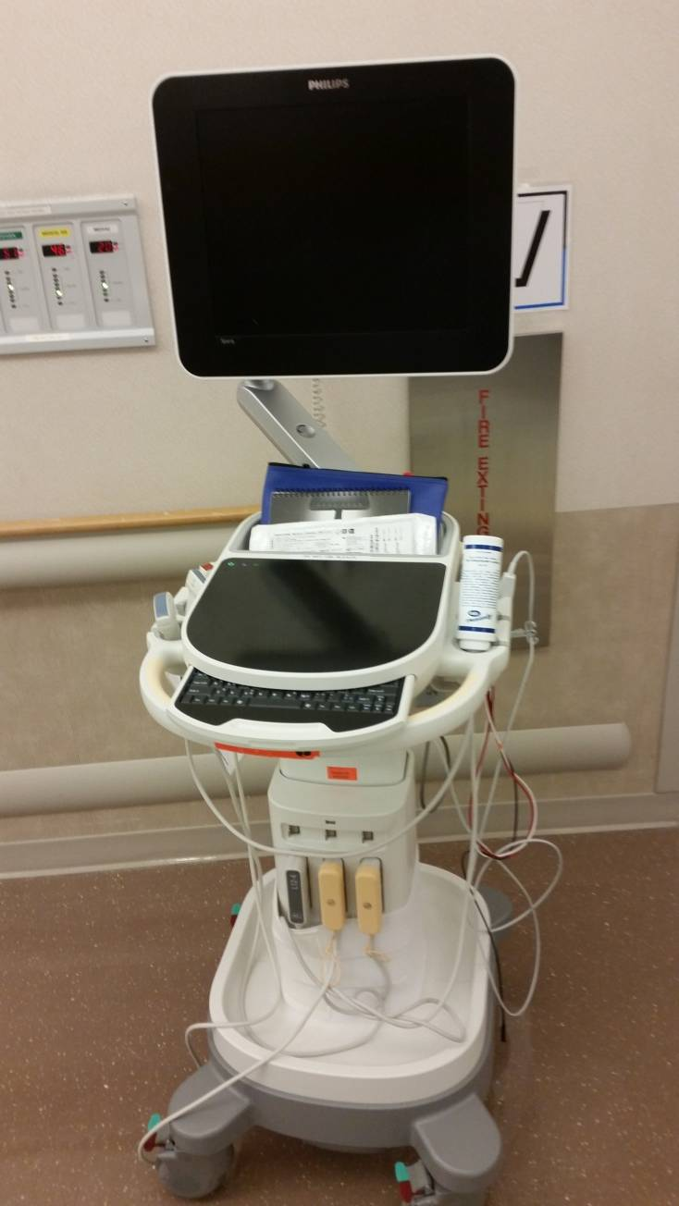
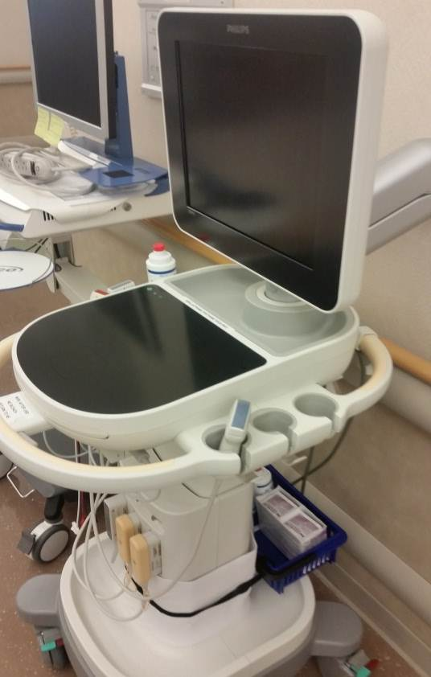
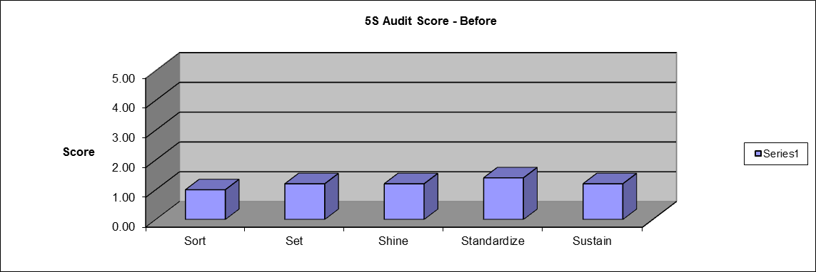
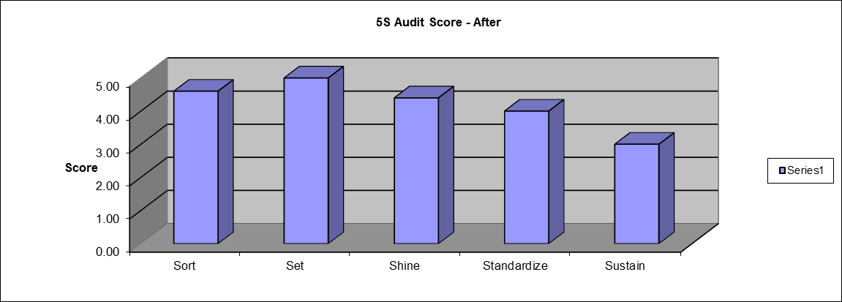

5S: Before and After Pictures
Before
After
Before
After
Before
After

Slide 72
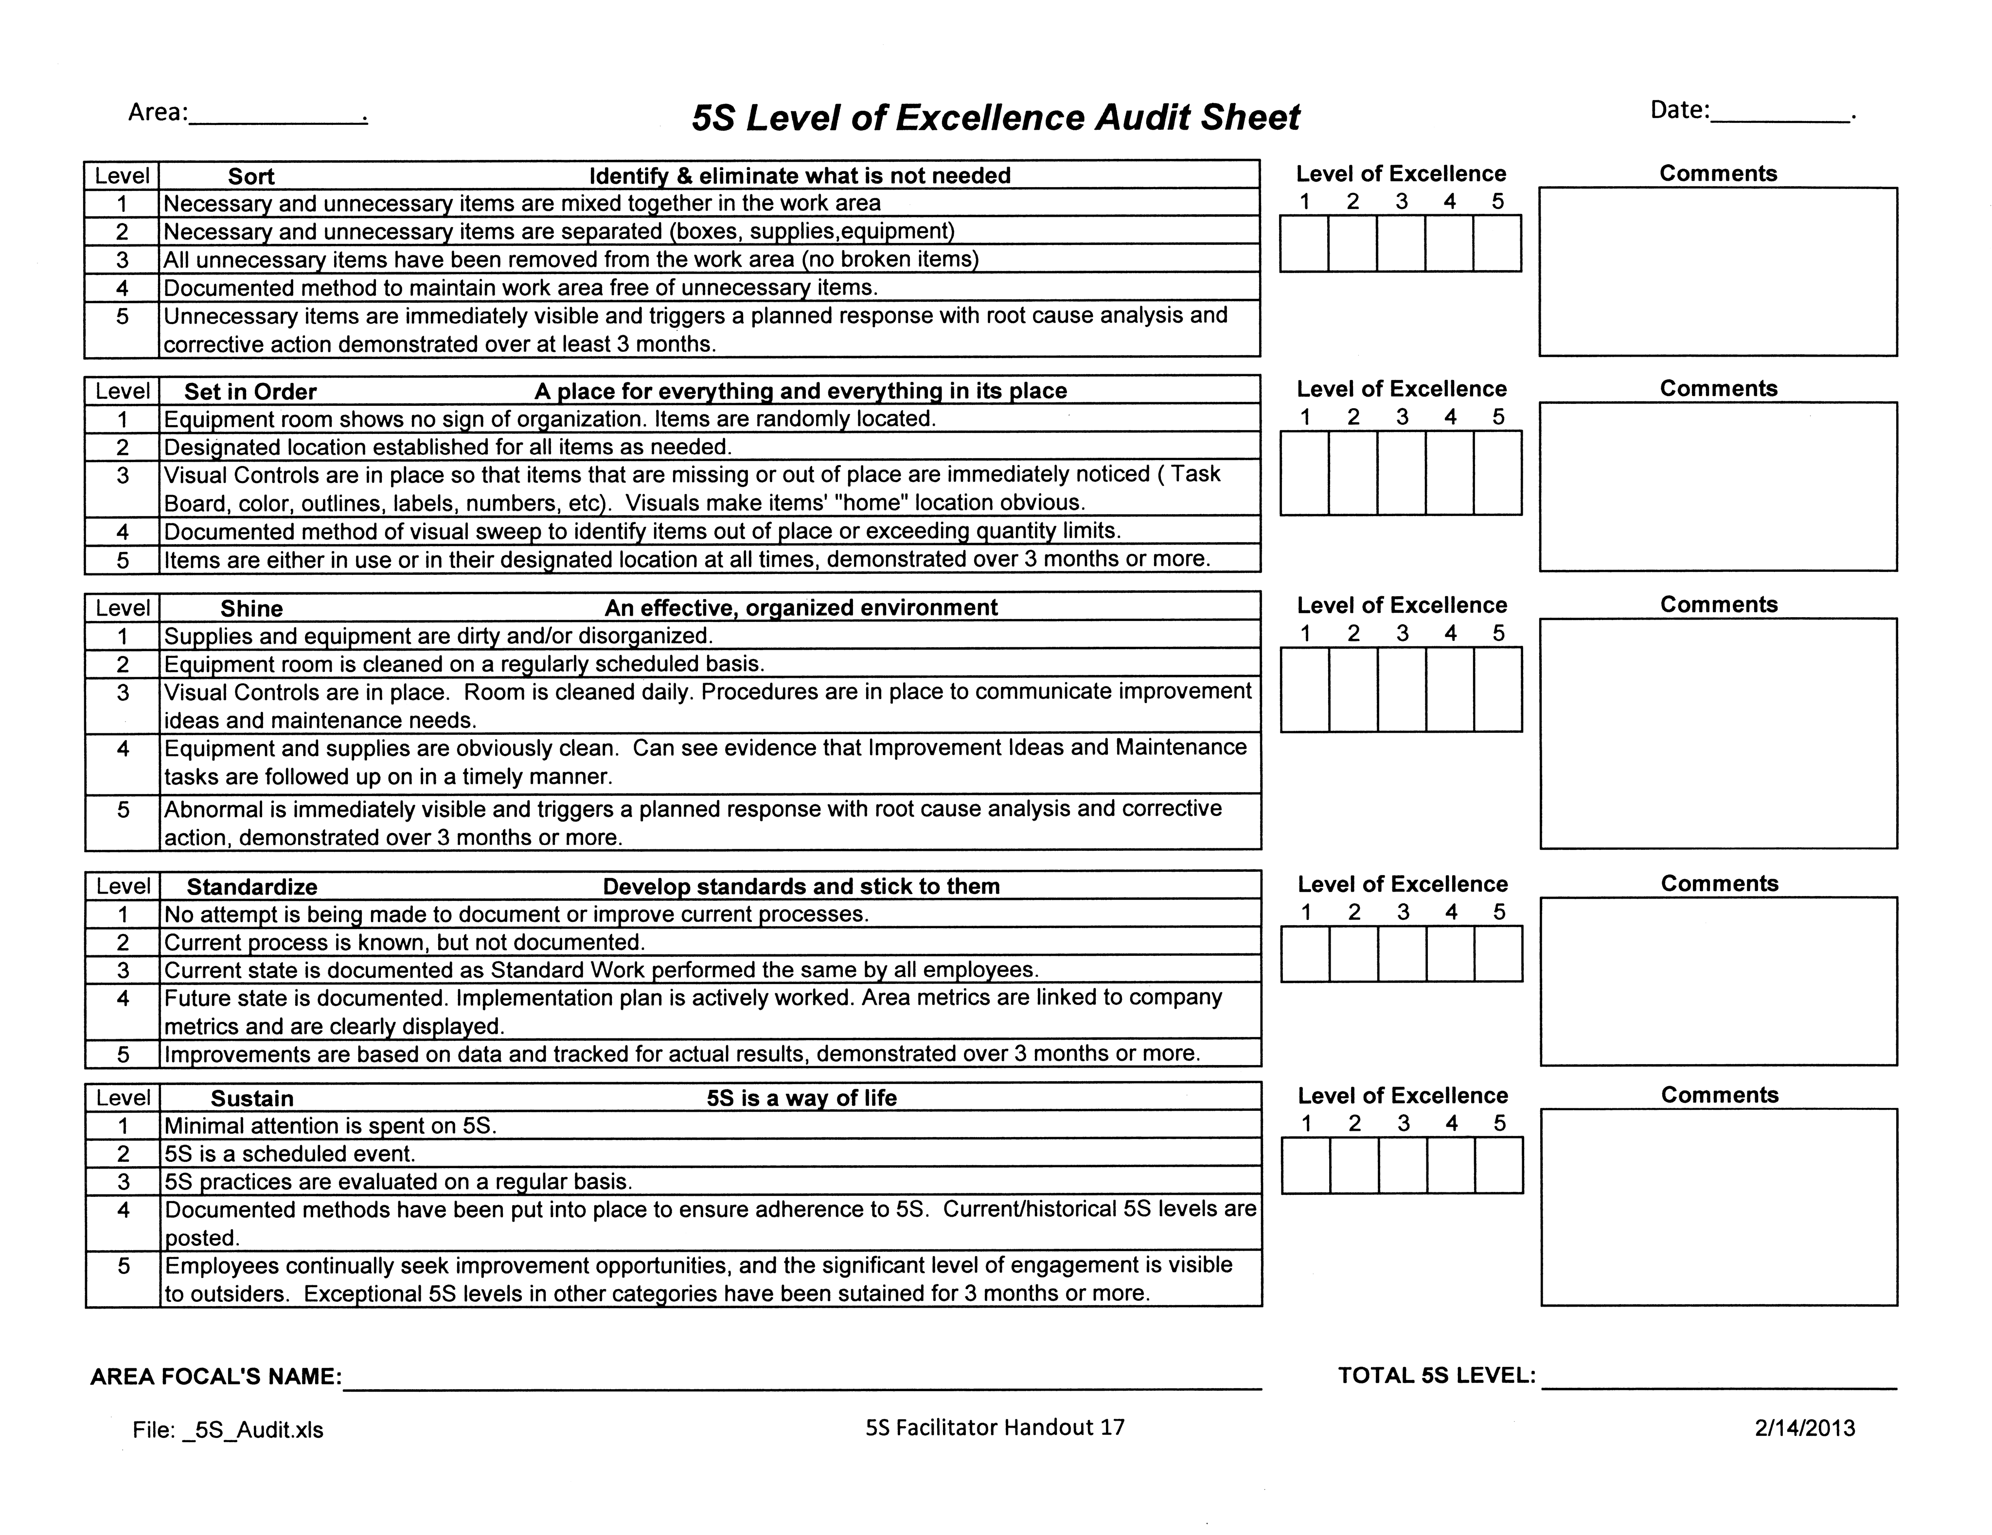
Measure
Measure
Measure
5S Audit Sheet
Workbook, p. 73

Slide 73
Lean Simplified
Streamline the Value Stream (Work or Process Flows & Layouts)
Pull vs Push
Predictability & Consistency (Quality) – e.g. Mistake Proofing
Workplace organization (5S)
Visual Workplace (Visual Management)
Continuous Improvement (PDSA)

Slide 74
LEAN - Visual Management
Workbook, p. 74

Slide 75
Examples of Visual Management

Slide 76
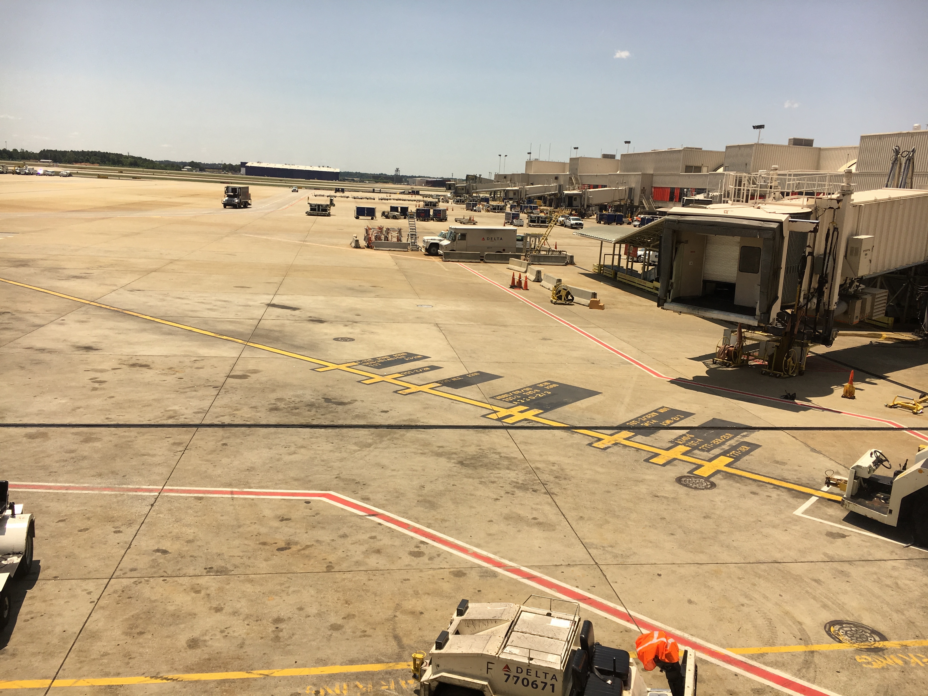
Making quality/safety/efficiency visible & therefore, easy to do!

Slide 77
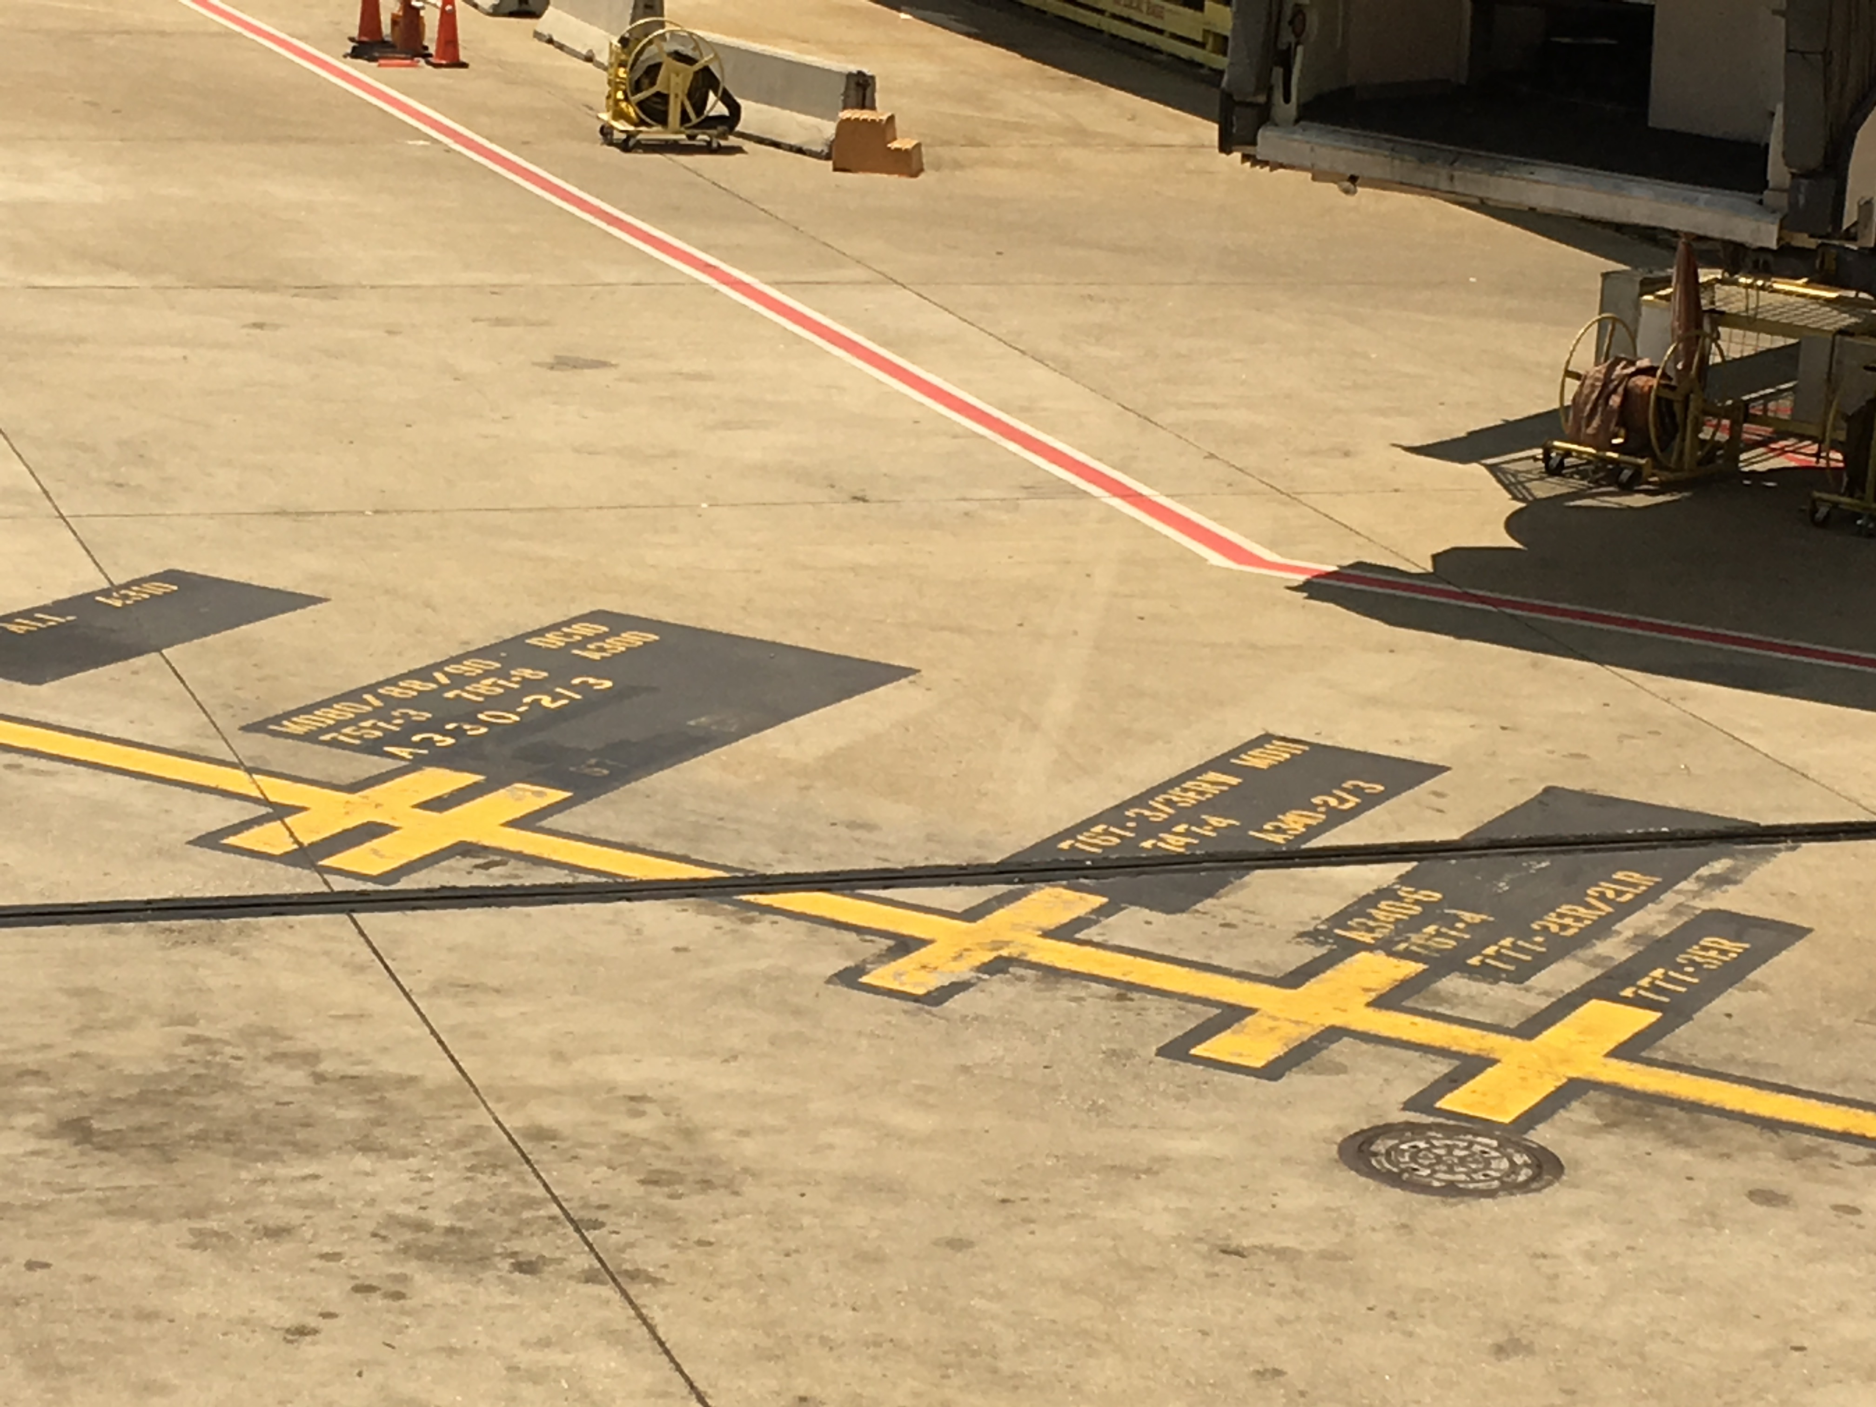
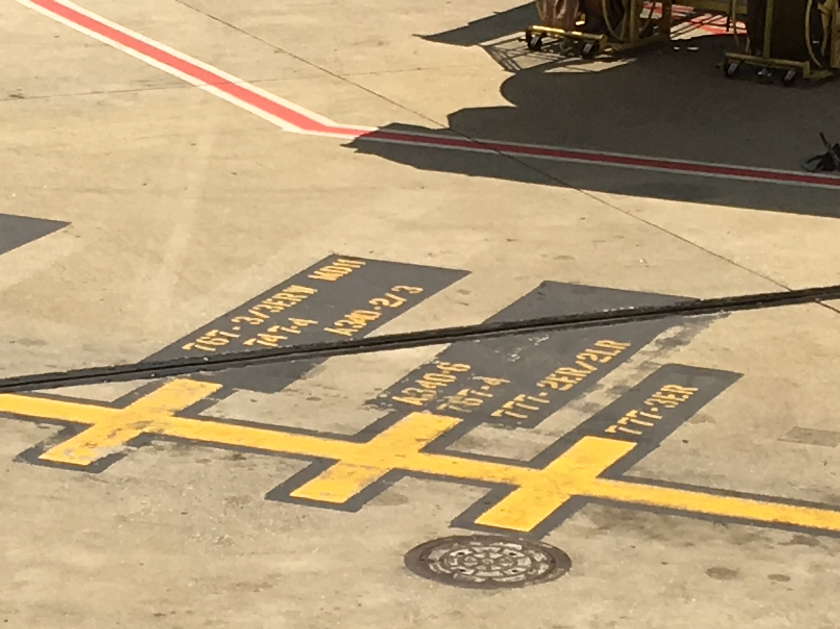

Slide 78


Slide 79
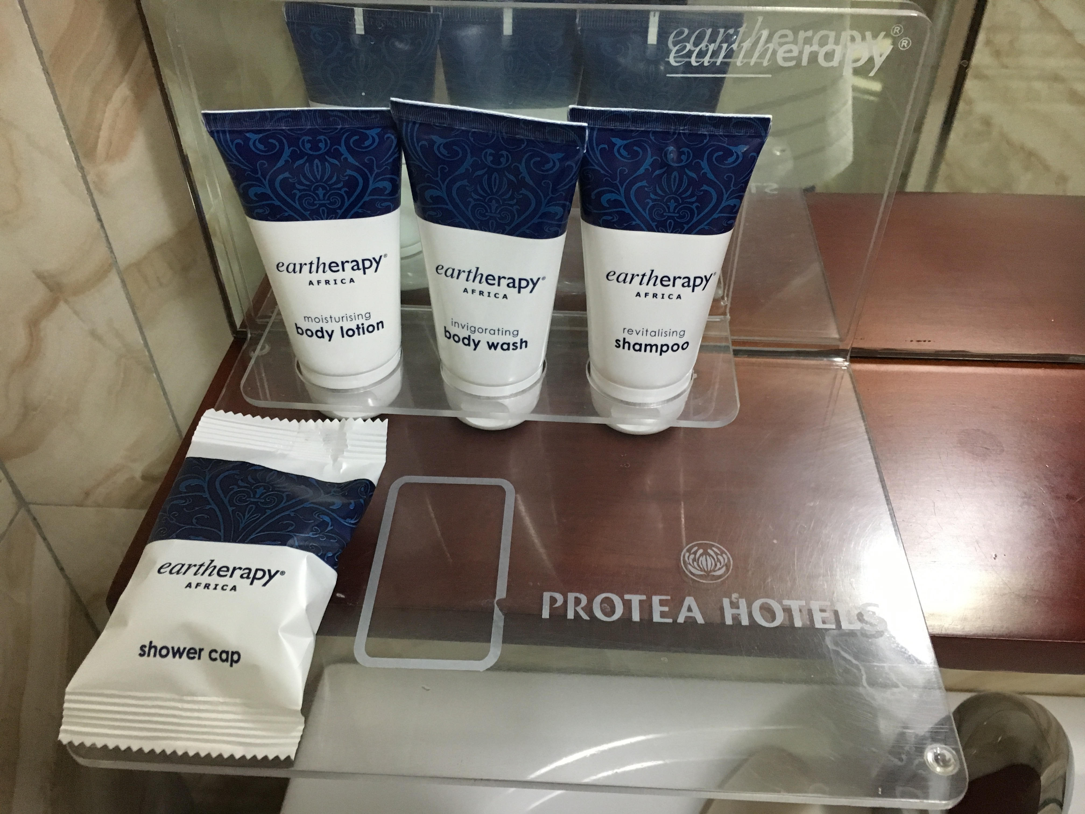
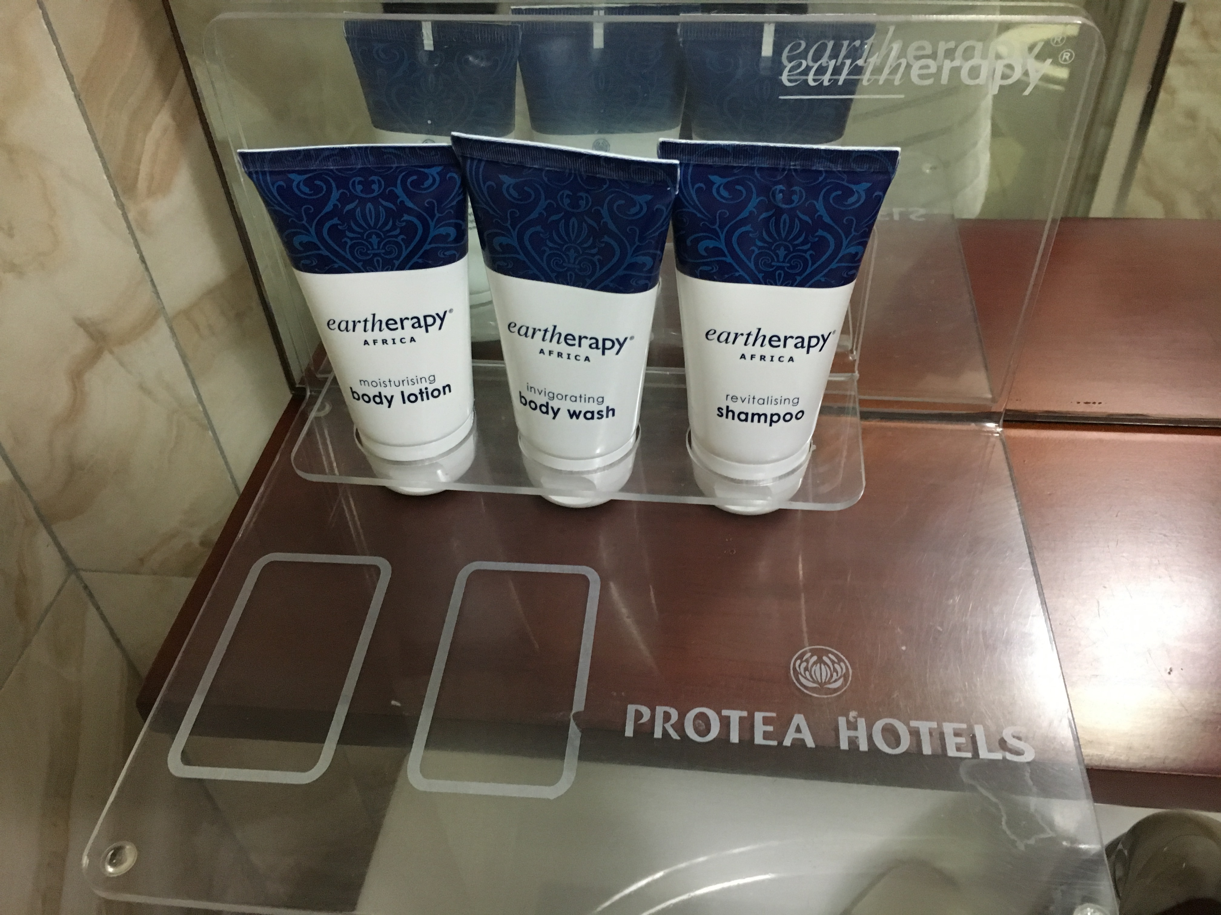
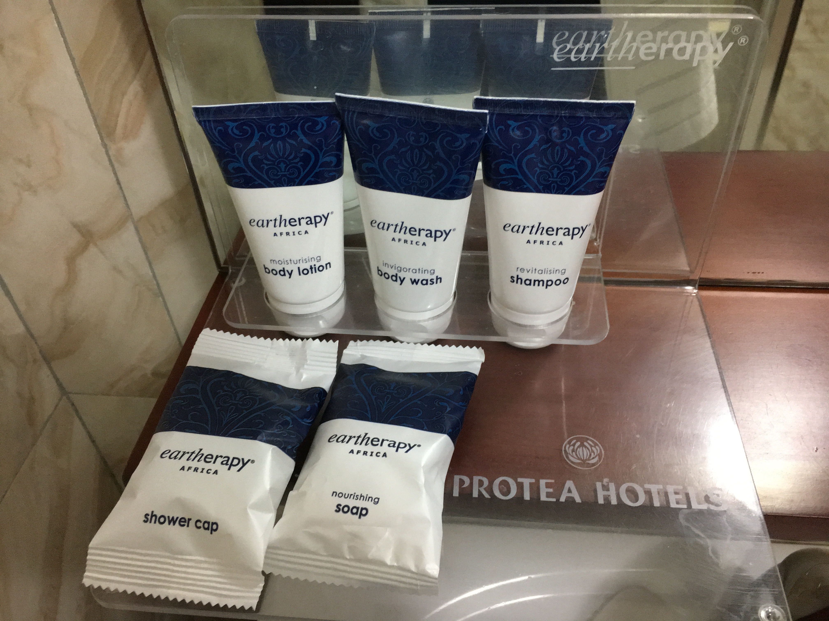

Slide 80
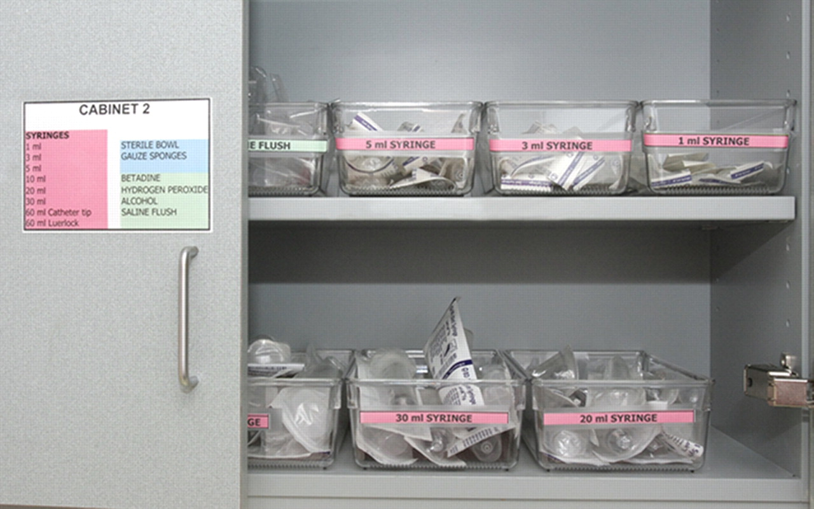

Slide 81
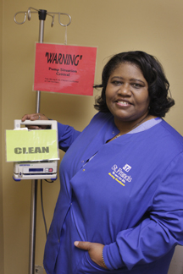

Slide 82
Making Processes Visible

Slide 83
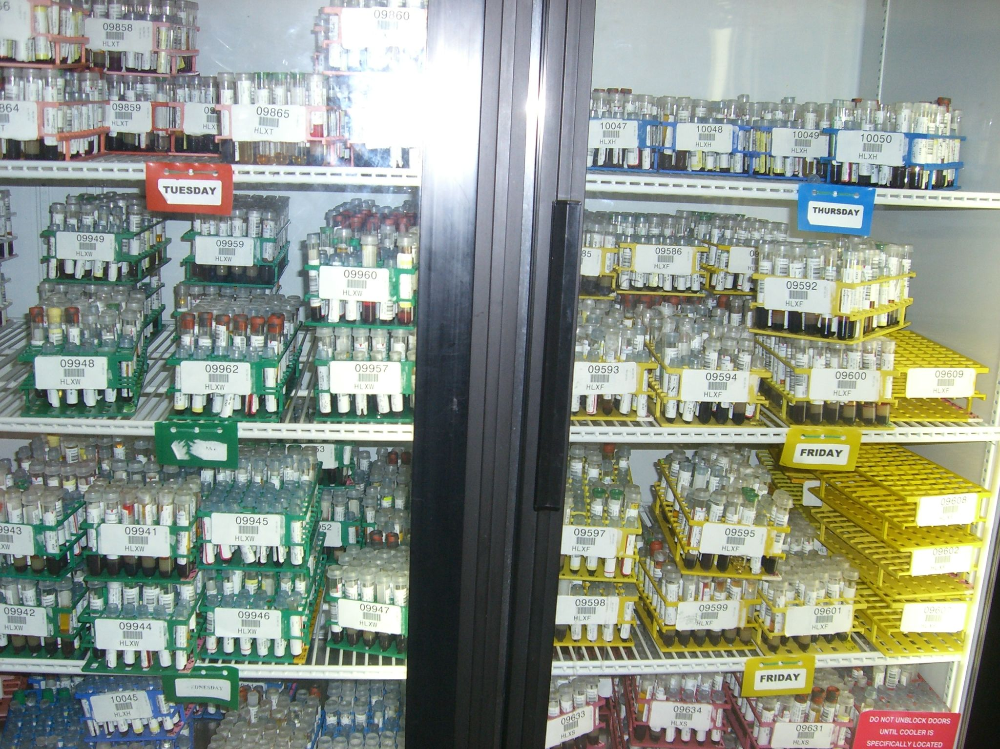

Slide 84
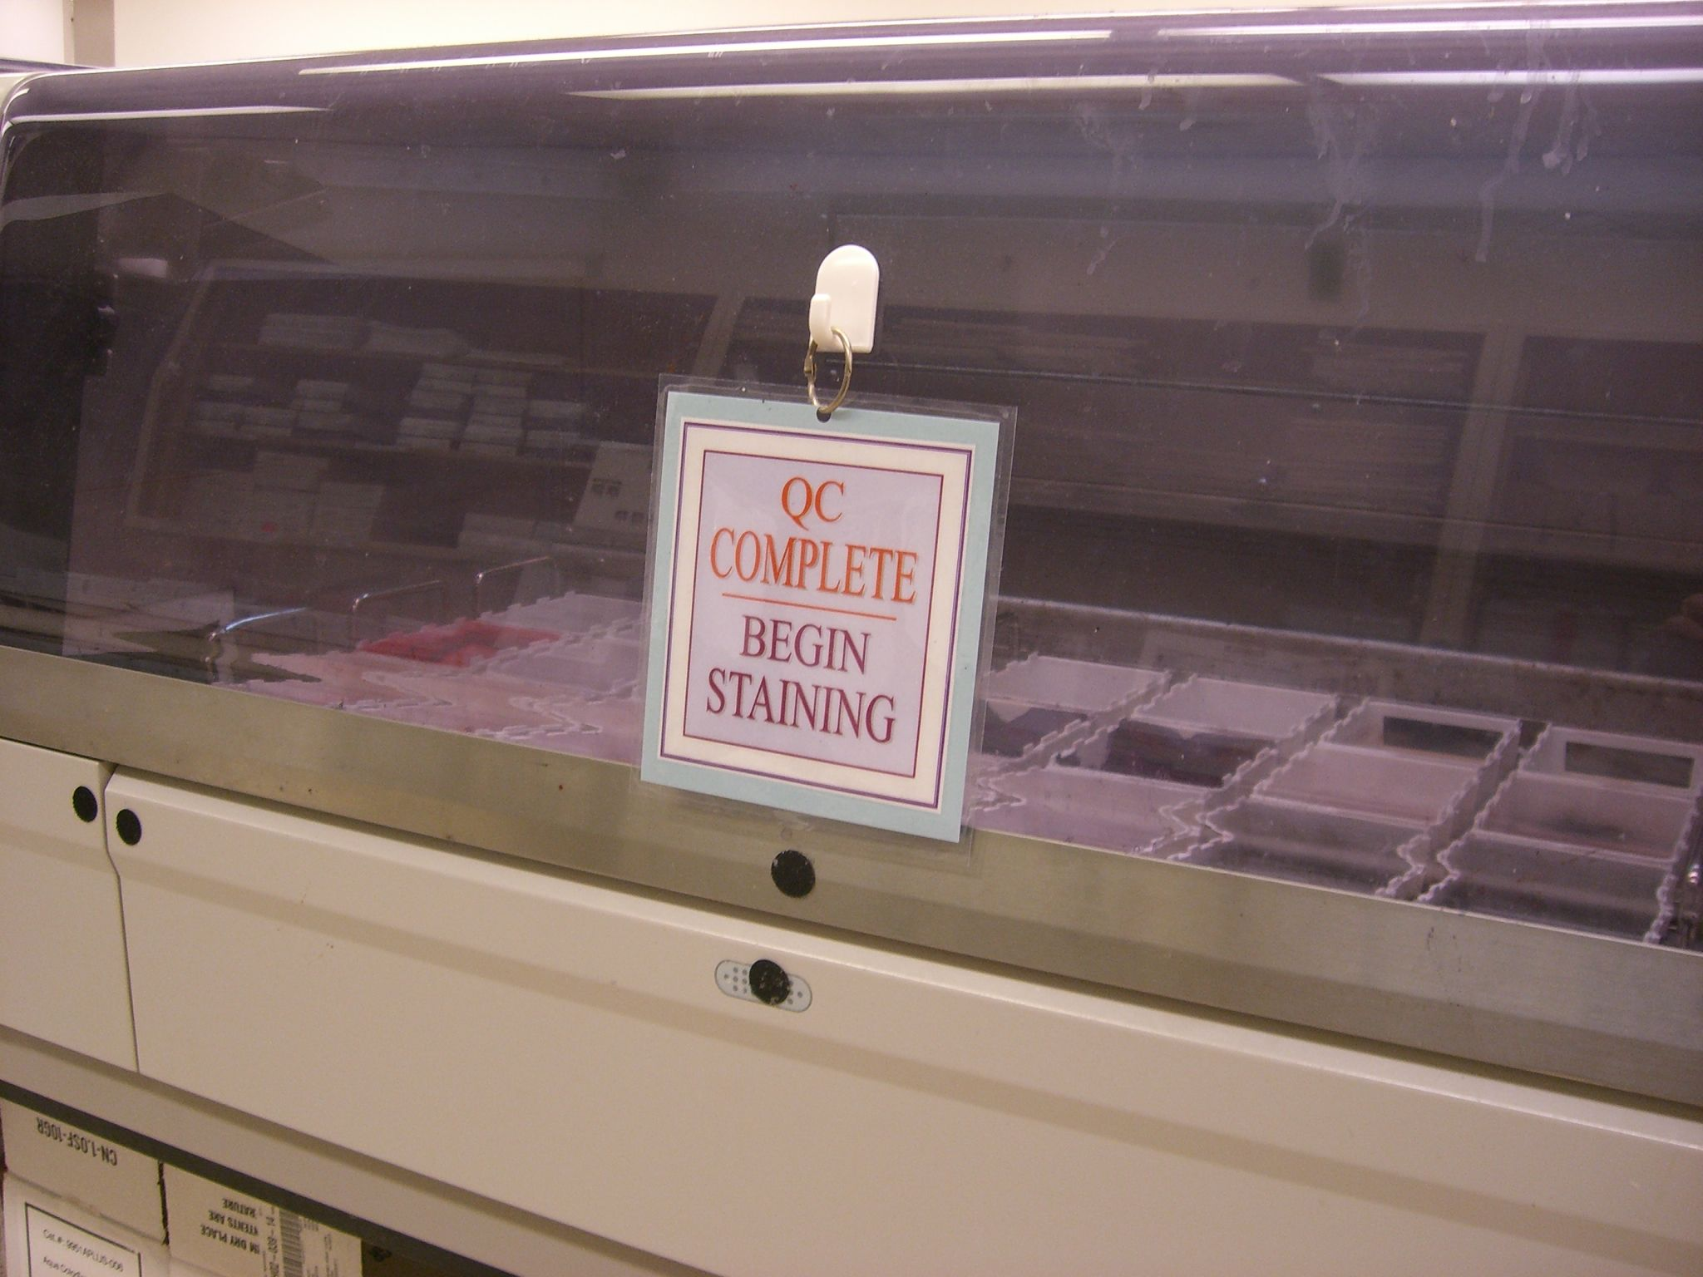

Slide 85
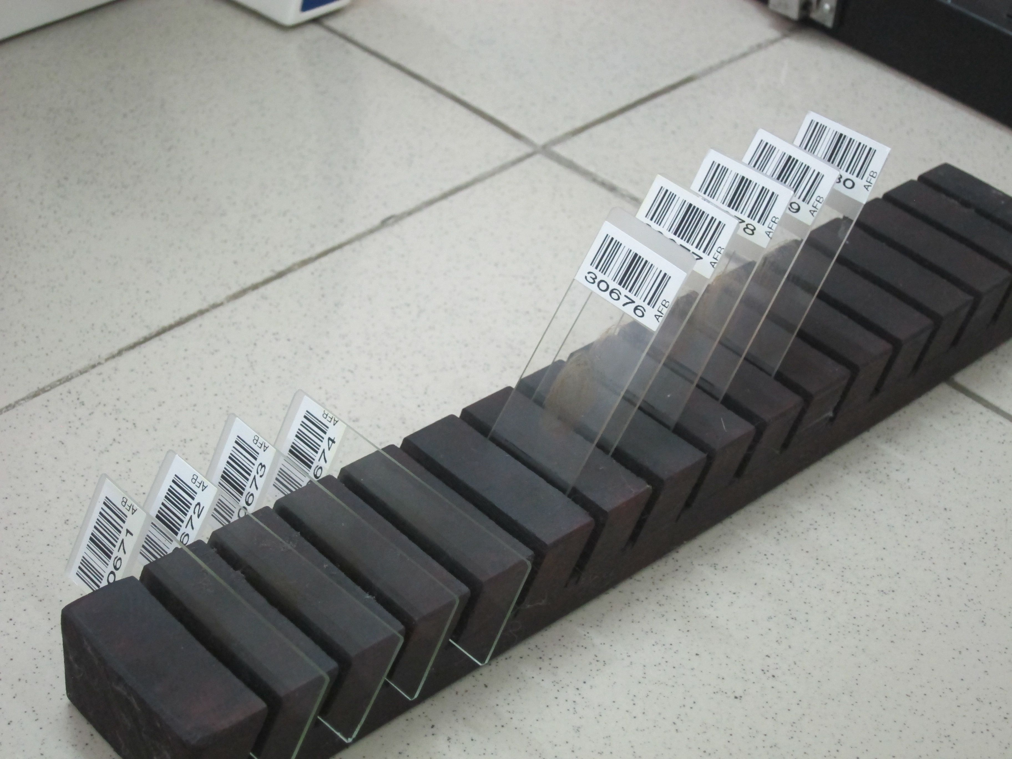

Slide 86


Slide 87
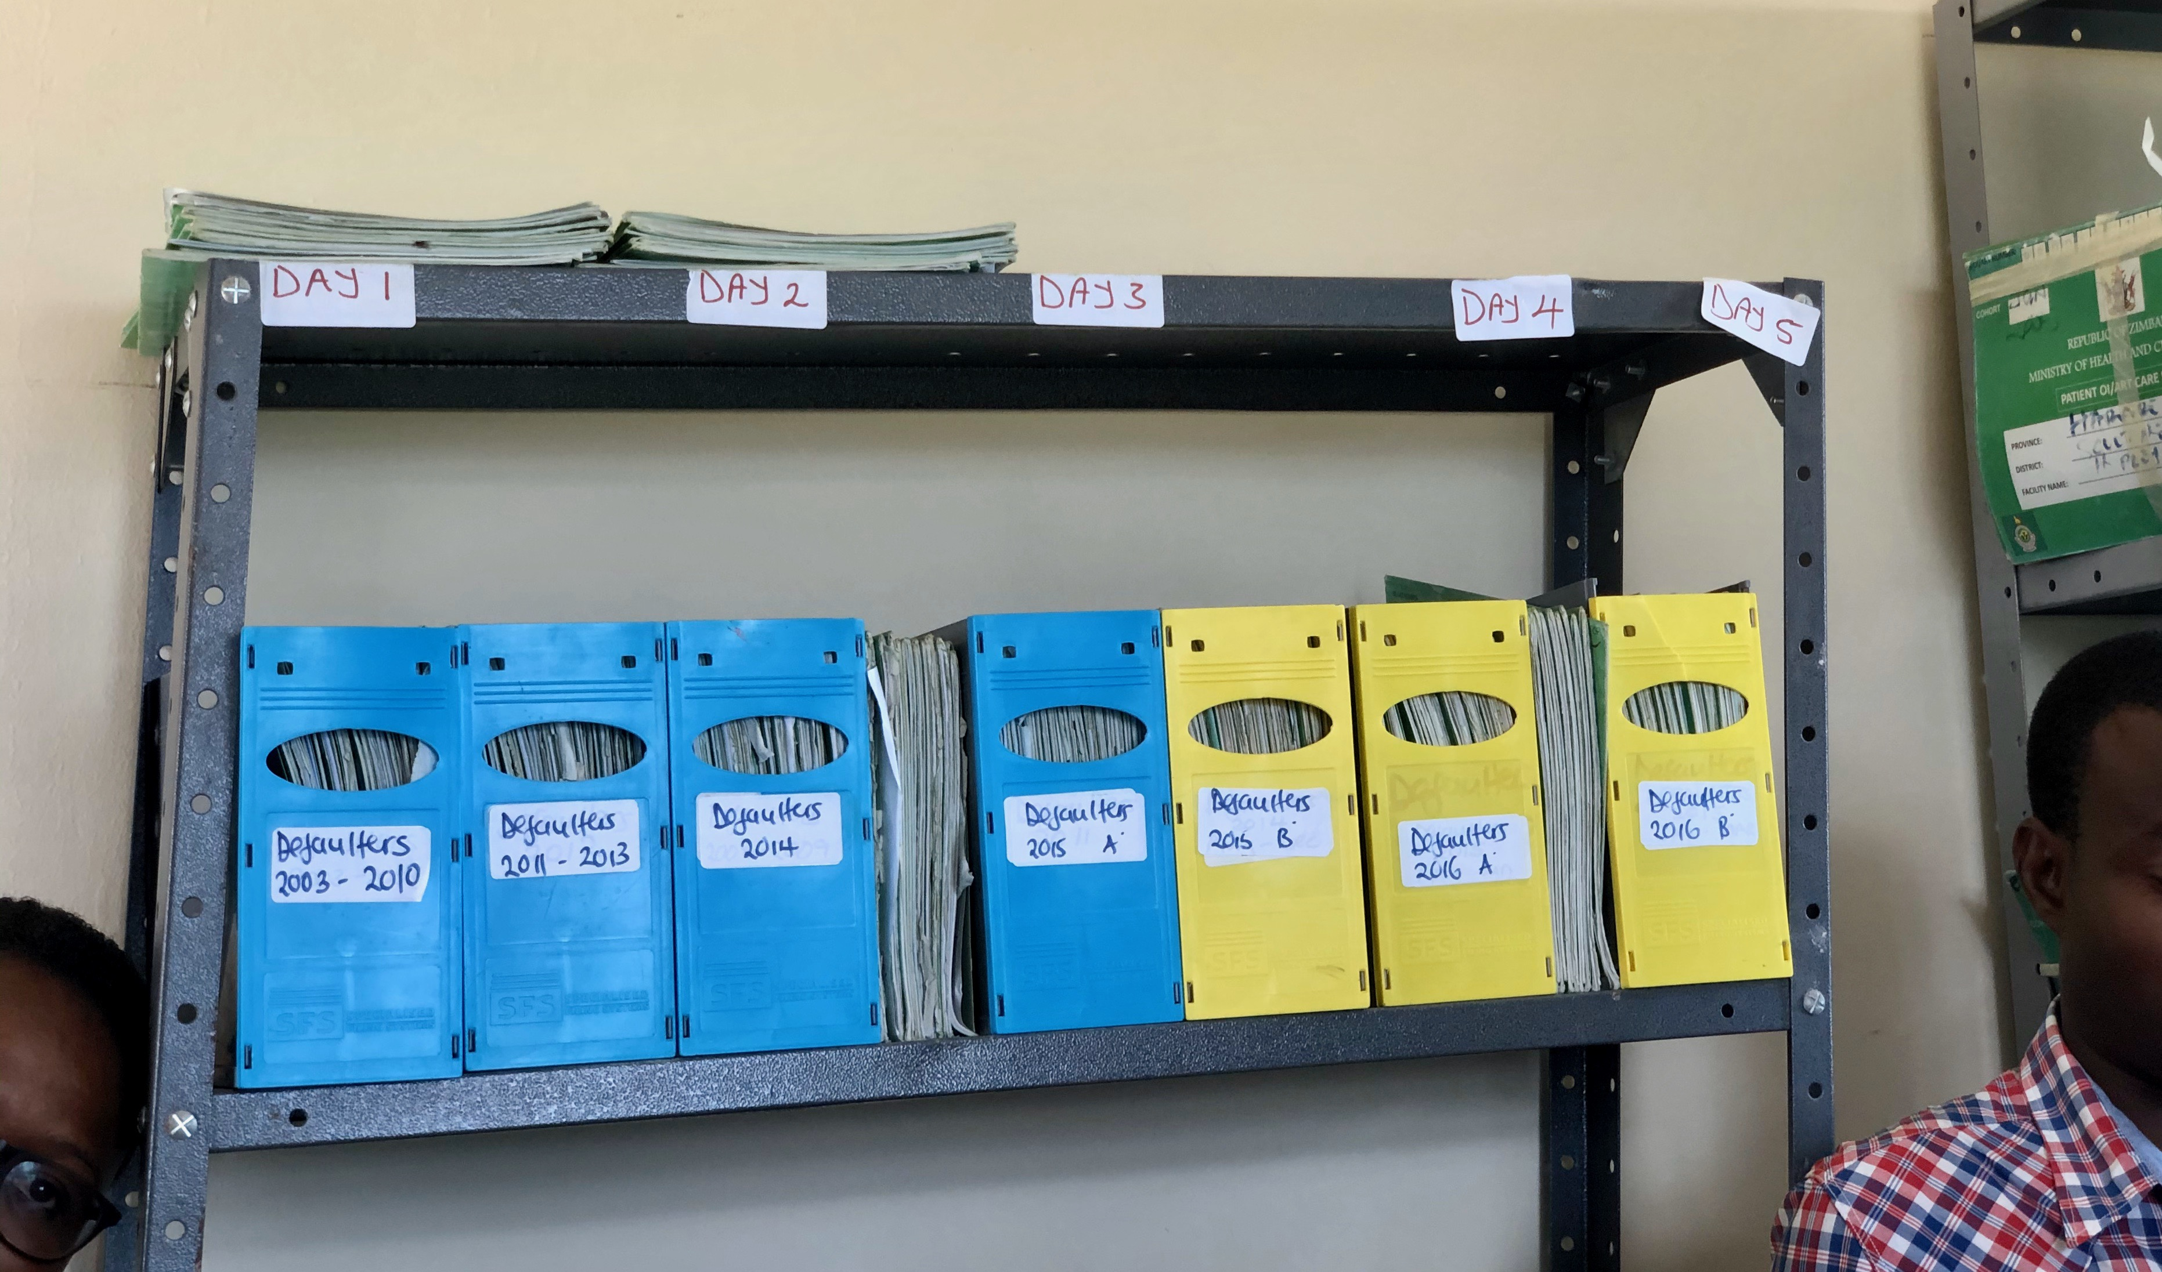

Slide 88
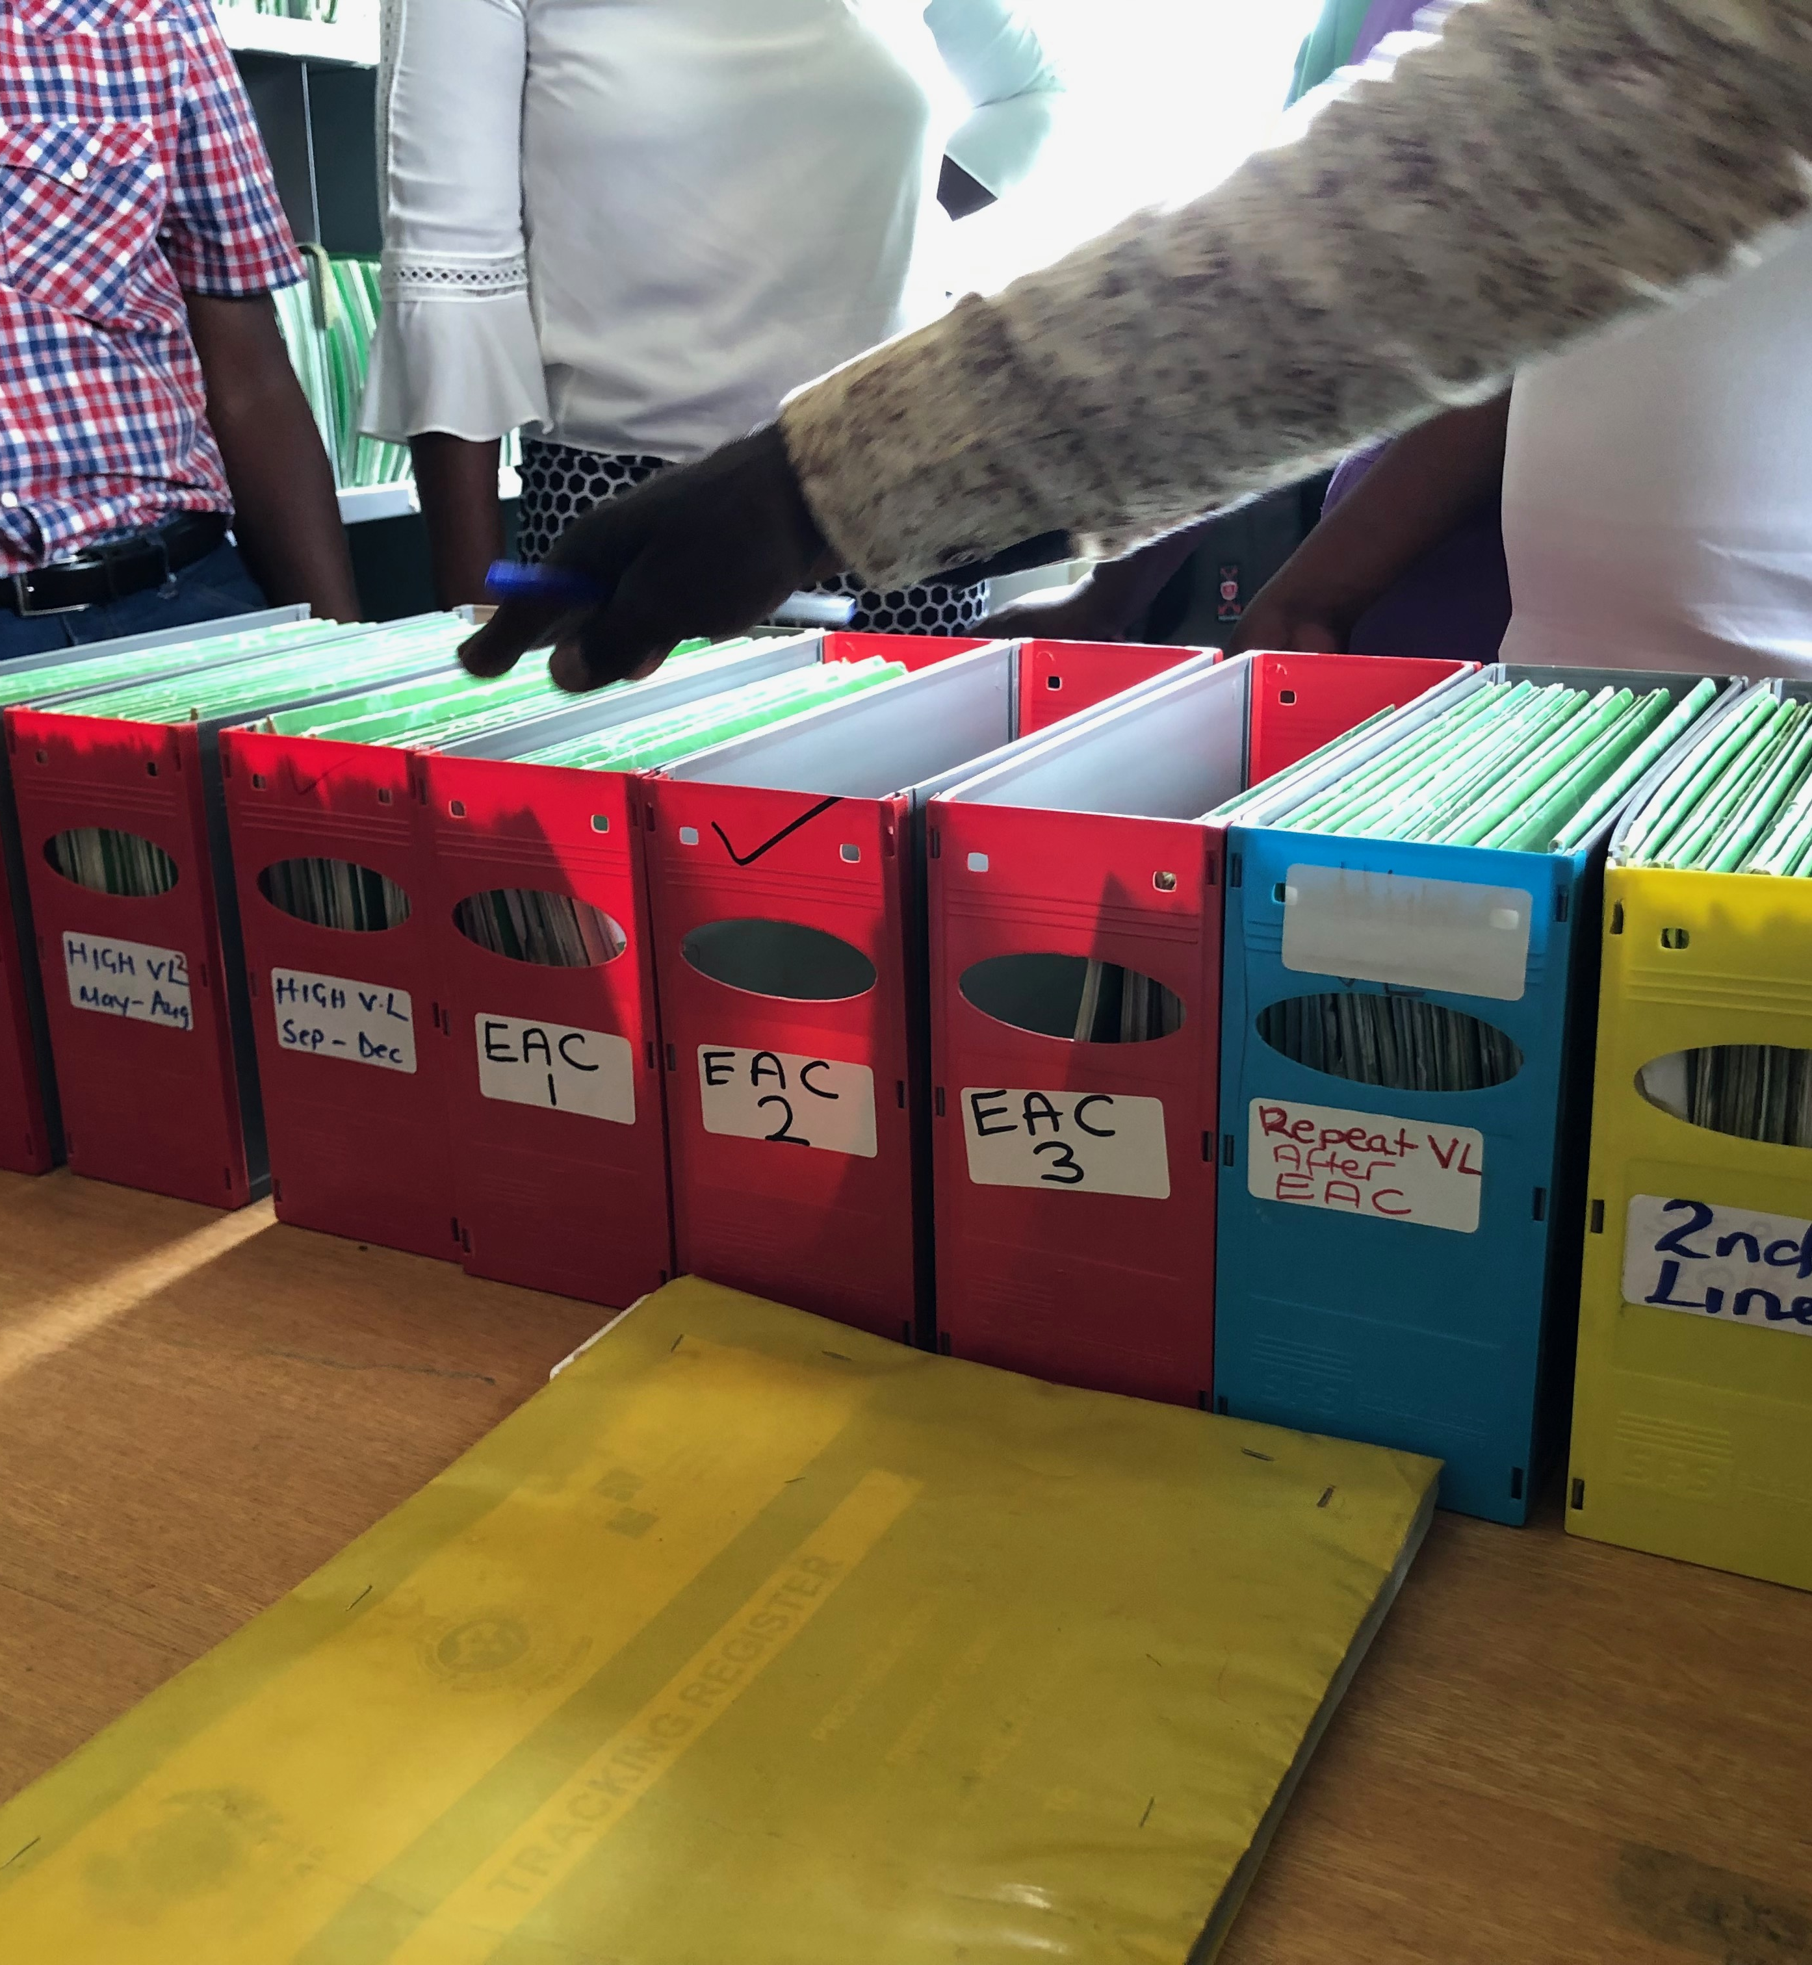
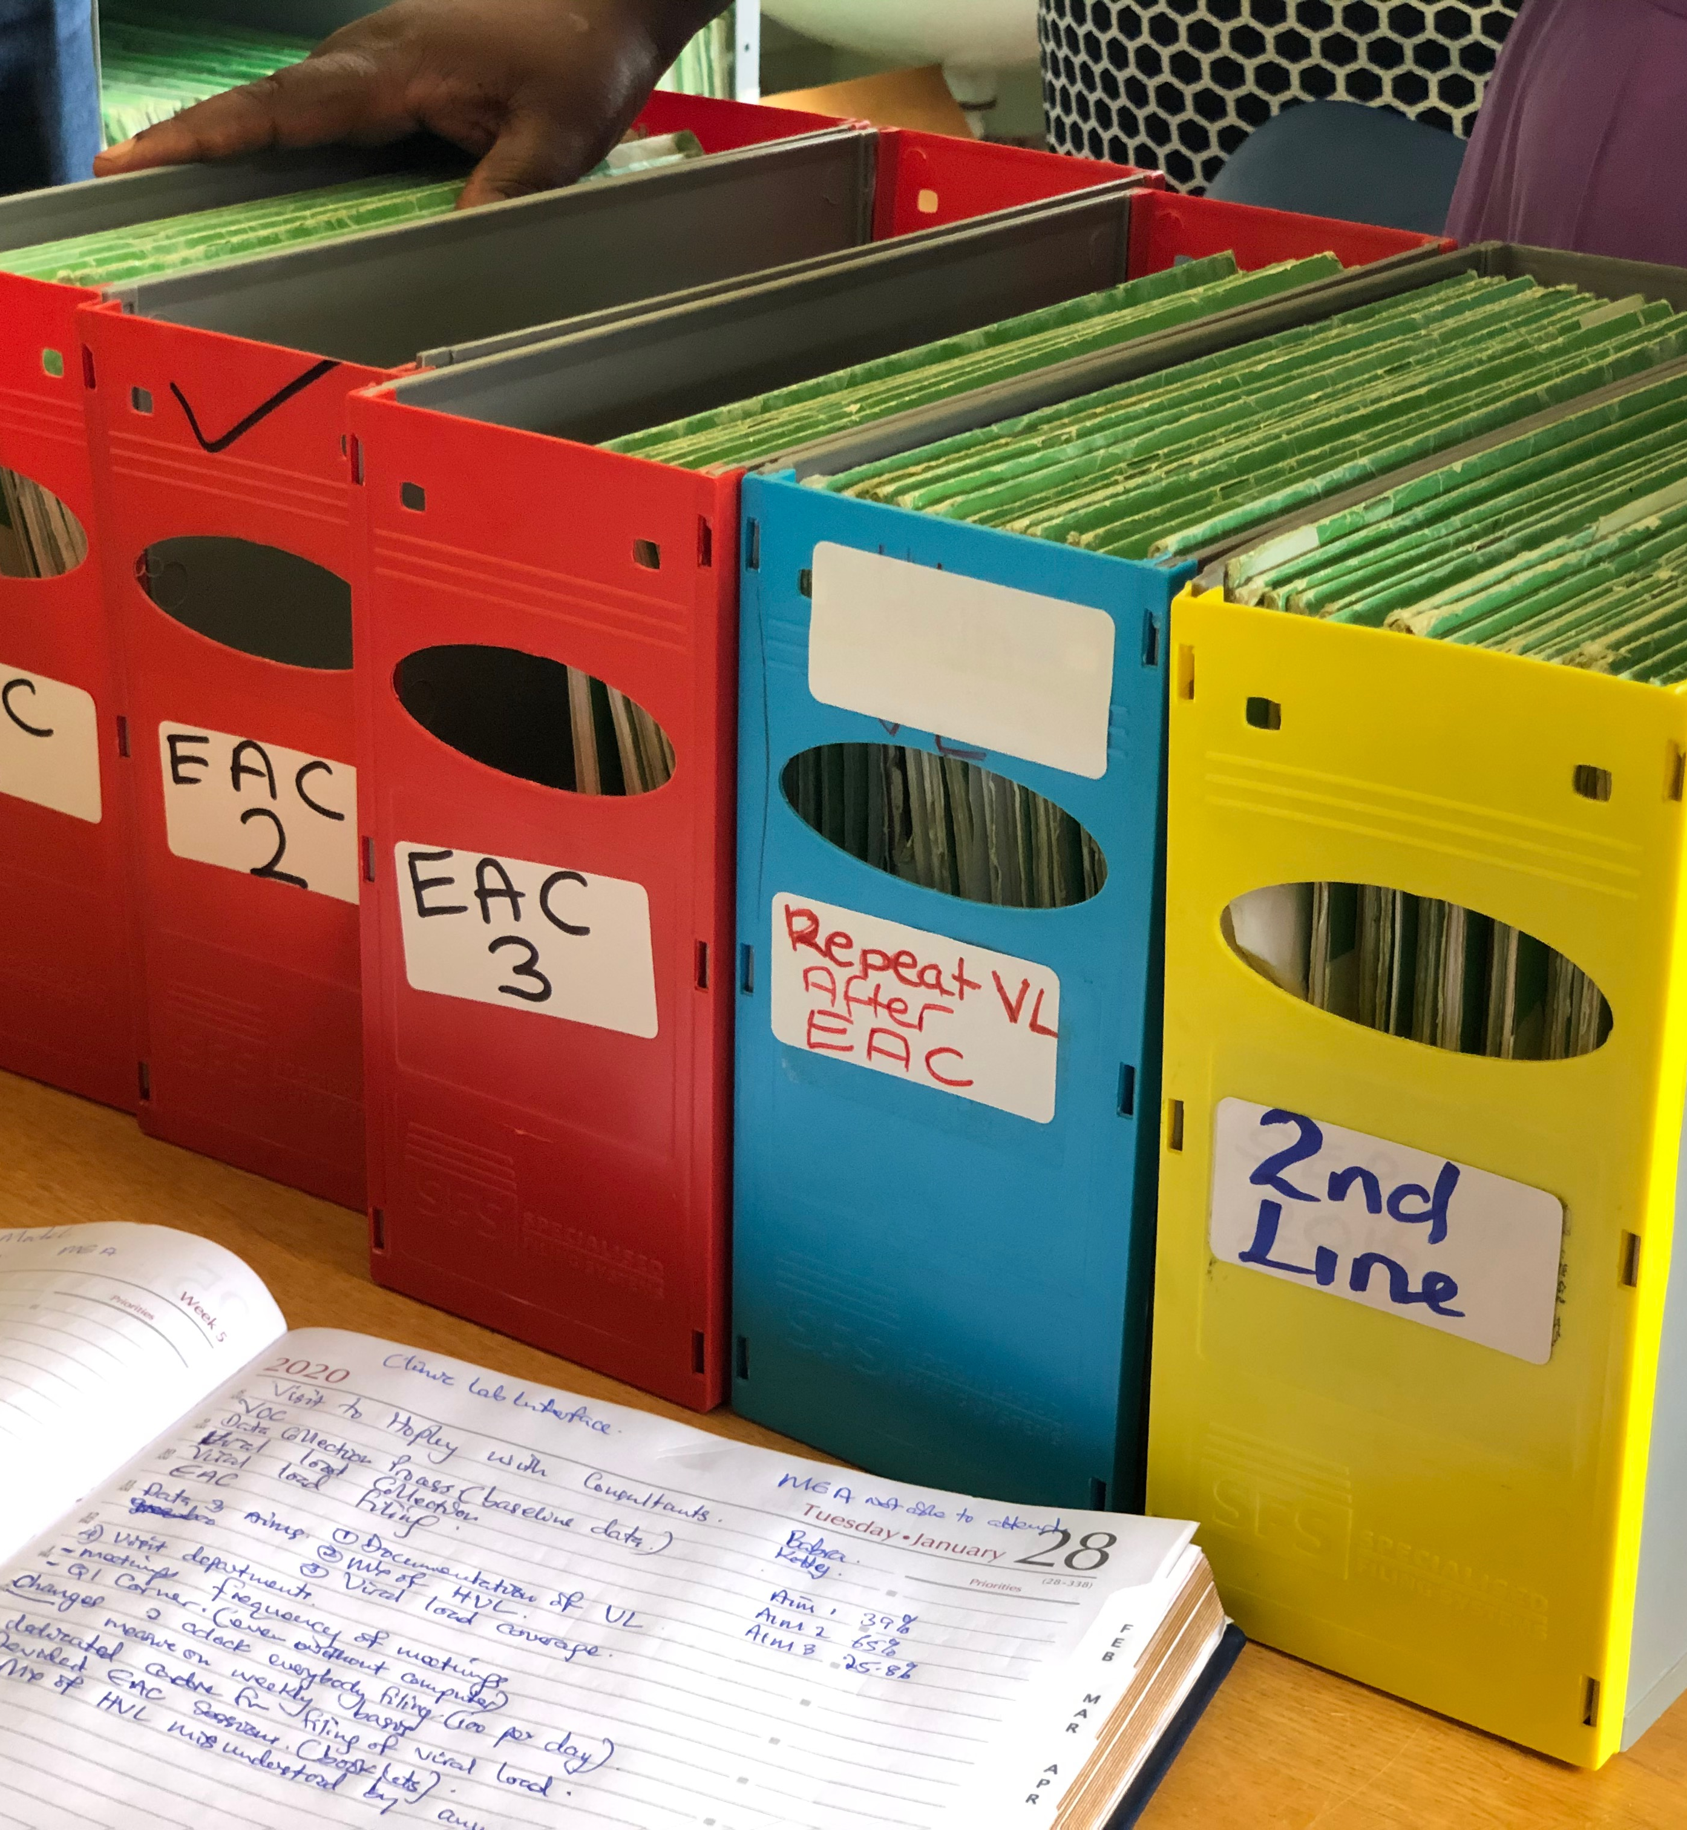

Slide 89
Your Project Deliverables
PDSAs
Create a future state process map
Communicate your new process = your change = your standard work → Create an SOP
5S
Visual Management

Slide 90
Armed with Tools –
Now Work on Your ED Flow Again

Slide 91
Change concepts (9 categories) IHI – QI 102
1. Eliminate waste
2. Improve workflow
3. Optimize inventory
4. Enhance the producer-customer relationship
5. Change the work environment
6. Manage time
7. Manage variation → Standardize
8. Design systems to prevent errors = Error Proofing
9. Focus on the design of products and services

Slide 92
Things to Ponder…
Wastes that can be eliminated
PDSA may not be perfect first time
Combine responsibilities
Establish pull
No batching
Reduced distances and transport
What is critical to patient outcome
Better communication
Supplies at point of use
Ergonomics
Built in quality
Level workload
What is of value
Proper training and multiple competencies
Reduce patient and staff waiting
Visual indicators
Notes:
92

Slide 93
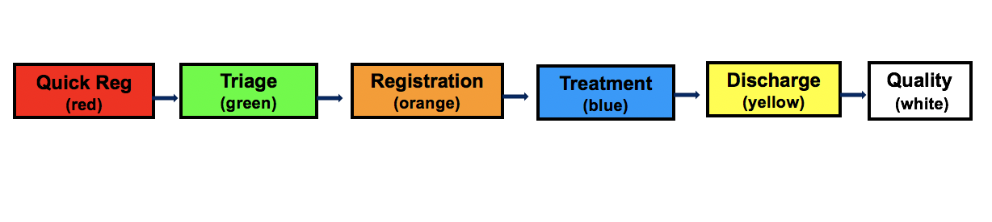
Simulation

Slide 94
ACTIVITY
Conduct an Emergency Department Simulation: Provide “care” (dots) to your “patients” (paper sheets)
Redesign your process using the tools learned today
Goal: “Treat” as many patients as possible in the time given
Debrief with the group
What you will need:
Table top signs (Workstations)
Work Instructions
Patients (Dot Sheets)
Dots – Multiple Colors
Timer
Flip Chart
Markers
20 + 5 MIN

Slide 95
Metrics
TEAM | # of Patients Treated (Completed) | # Treated “Correctly” | # Patients in Process | Time to First Patient Completed
1
2
3

Slide 96
ACTIVITY
Conduct an Emergency Department Simulation: Provide “care” (dots) to your “patients” (paper sheets)
Redesign your process using the tools learned today
Goal: “Treat” as many patients as possible in the time given
Debrief with the group
What you will need:
Table top signs (Workstations)
Work Instructions
Patients (Dot Sheets)
Dots – Multiple Colors
Timer
Flip Chart
Markers
20 + 5 MIN

Slide 97
Debrief – Phase #2
How did it go this time?
How were the outcomes?
Are there additional improvements you could make for Day 3?
Was it easier?
Are good systems important?

Slide 98


Slide 99
Session 2 Deliverables
Improve
  Update Project Outline, if necessary
1 5S Exercise
1 Visual Management Application
2 or more Tests of Change (PDSA)
Select and Implement Change
Modify Solution(s) where necessary by additional Test of Change (PDSA)
Data Display
Create Future State Map
Create Standard Work
Presentation

Slide 100
Data Display
Project Learning Board
Creating a Run Chart
Workbook, p. 55

Slide 101
LEARNING BOARD
PROJECT |  |  |  | JUST DO IT
Aim | Metric | Changes |  | Identified Opportunities | Actions | Resolved
Workbook, p. 16-17

Slide 102
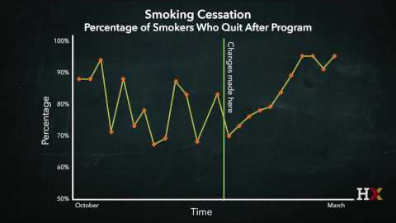
Learning from Data: Creating a Run Chart
IHI QI 103: Lesson 2 – How to Use Data for Improvement; David Williams, PhD Video, Page 3/8

Slide 103
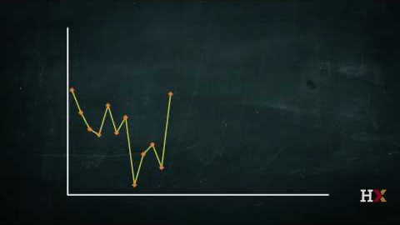
Tracking Data Over Time: Creating a Run Chart
IHI QI 103: Lesson 2 – How to Use Data for Improvement; David Williams, PhD Video, Page 4/8

Slide 104
Run Chart – WHY?
COMMUNICATION, COMMUNICATION, COMMUNICATION
  “Graphs tell a story”
Team Engagement
    Seeing where we are and where we want to be
    “Outcomes & goals that are not made visual will fail”
  Maintains focus
  “Friendly” competition

Slide 105
ACTIVITY:
Viral Load - % of Results Recorded in Green Book
Month | % of Results Recorded in Green Book
October 2018 | 37%
November 2018 | 42%
December 2018 | 26%
January 2019 | 42%
February 2019 | 51%
March 2019 | 28%
Notes:
Say, “take a quick look at this data and tell me whether the percent of viral load tests recorded in green book is increasing or declining or staying about the same?”
Is this data easy to “read”? Does it tell you clearly about documentation of VL test results? Is it visual? Is it impactful?

Slide 106
ACTIVITY
Create a “Run Chart”: Make the “Percentage of Viral Load Results Documented” visible and impactful
Given the VL documentation results, create a run chart to communicate how the documentation has changed over time.
Display at front of classroom or Review with the Group
Debrief with the Group
What you will need:
Run Chart Template or Graph Paper
Data
Creating a Run Chart: Tips
Pencils
15 MIN

Slide 107
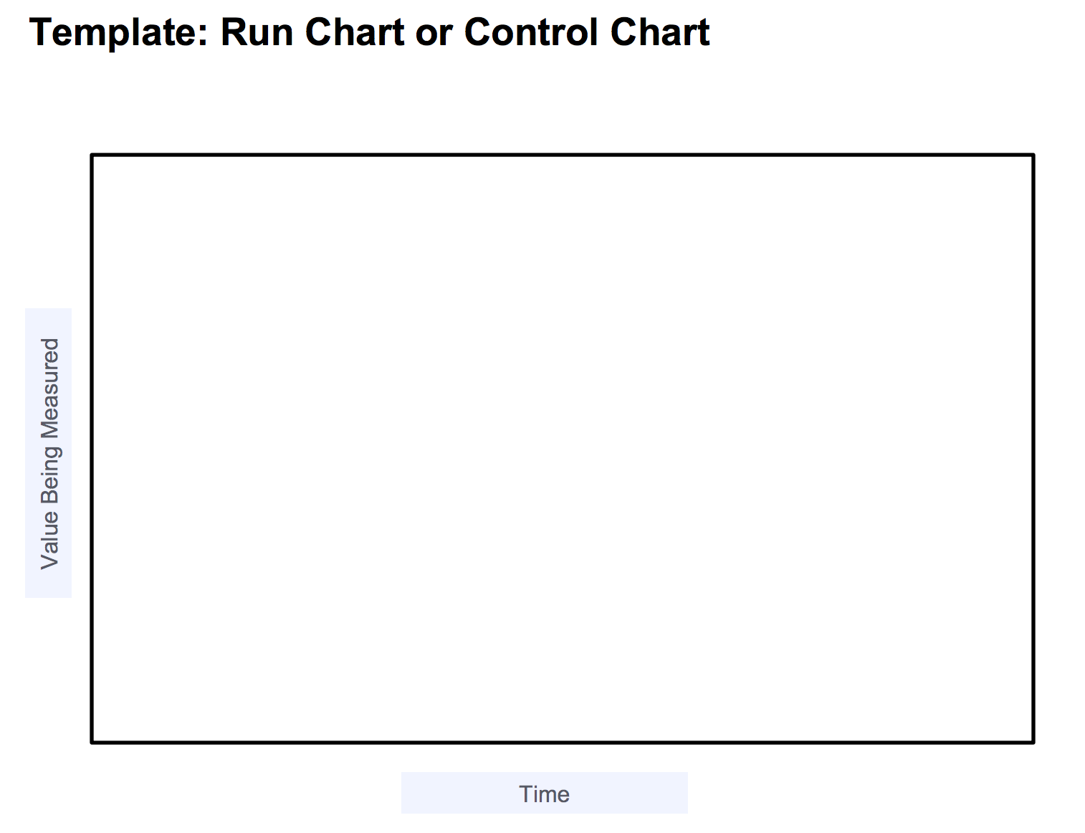
ACTIVITY:

Slide 108
ACTIVITY:
Viral Load - % of Results Recorded in Green Book
Month | % of Results Recorded in Green Book
October 2018 | 37%
November 2018 | 42%
December 2018 | 26%
January 2019 | 42%
February 2019 | 51%
March 2019 | 28%

Slide 109
ACTIVITY
Create a “Run Chart”: Make the “Percentage of Viral Load Results Documented” visible and impactful
Given the VL documentation results, create a run chart to communicate how the documentation has changed over time.
Display at front of classroom or Review with the Group
Debrief with the Group
What you will need:
Run Chart Template or Graph Paper
Data
Creating a Run Chart: Tips
Pencils
15 MIN

Slide 110
Run Chart
Month | % of Results Recorded in Green Book
October 2018 | 37%
November 2018 | 42%
December 2018 | 26%
January 2019 | 42%
February 2019 | 51%
March 2019 | 28%

Slide 111
Direct Assistance Site #4 (UMB) | Result Reporting
Aim | To increase % HVL results documented in the green cards in patient files from 23% to 80% by March 2019 | Target exceeded
PDSA 4
PDSA 3
Interventions
Redesigned process flow for result handling
Redesigned the communication process
PDSA 2
PDSA 1
Notes:
Median = 100%

Slide 112
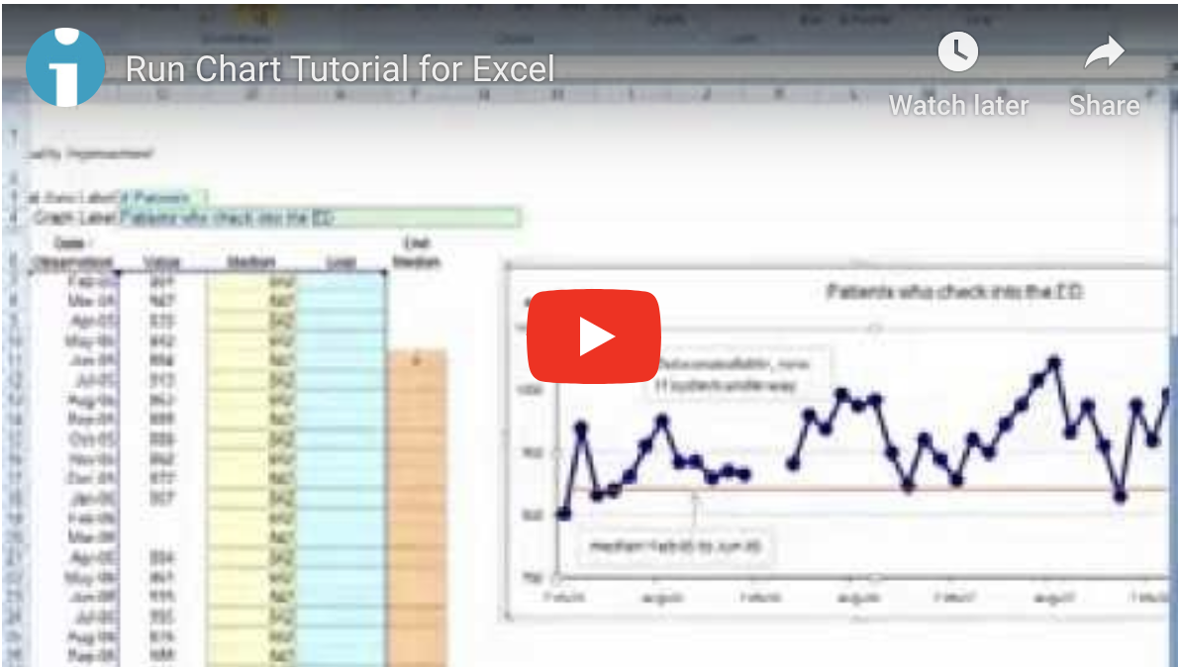
Additional Resources: IHI Open School:
Creating a Run Chart with Excel
IHI QI 104: Lesson 1 – How to Display Data on a Run Chart;
Run Chart Tutorial for Excel Video, Page 5 of 8.

Slide 113
Action Plan

Slide 114
Action Items Following LS #2
Action Items | By When?
Update LS#1 Deliverables / PPT: Use template, Remove all orange font, Update Summary Slide; VOC - Evaluate Data – Include Data Table, Differentiate Baseline from Post-Intervention Data
Conduct Team Meetings (Weekly)
Submit Data to MOH
Create Learning Board
5S
Visual Management
PDSA #1
PDSA #2 and more
Standard Work (SOP) for AIM #1 and #2
Future State Map for AIM #1 and #2
Data Display – Begin Run Chart for AIM #1 and #2
Presentation for LS #3

Slide 115
Site Visits

Slide 116
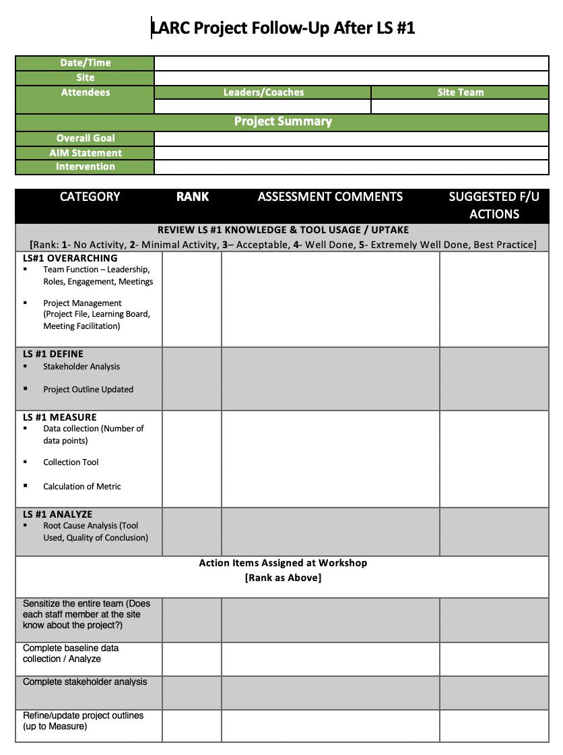
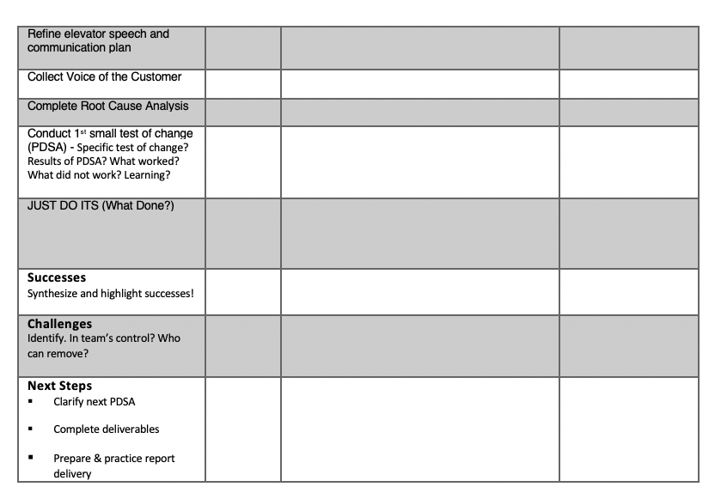
Site Visits

Slide 117
See you next time!

